Slide 1
Statistics
Bennie Waller
wallerbd@longwood.edu
434-395-2046
Longwood University 201 High Street Farmville, VA 23901

Slide 2
Hypothesis testing
Bennie Waller
wallerbd@longwood.edu
434-395-2046
Longwood University 201 High Street Farmville, VA 23901

Slide 3
Hypothesis Testing
HYPOTHESIS A statement about the value of a population parameter developed for the purpose of testing.
HYPOTHESIS TESTING A procedure based on sample evidence and probability theory to determine whether the hypothesis is a reasonable statement.
10-3

Slide 4
Important Things to Remember about H₀ and H₁
Hypothesis Testing
H₀ is always presumed to be true
H₁ has the burden of proof
A random sample (n) is used to “reject H₀”
If we conclude 'do not reject H₀', this does not necessarily mean that the null hypothesis is true, it only suggests that there is not sufficient evidence to reject H₀; rejecting the null hypothesis then, suggests that the alternative hypothesis may be true.
Equality is always part of H₀ (e.g. “=” , “≥” , “≤”).
“≠” “<” and “>” always part of H₁
10-4

Slide 5
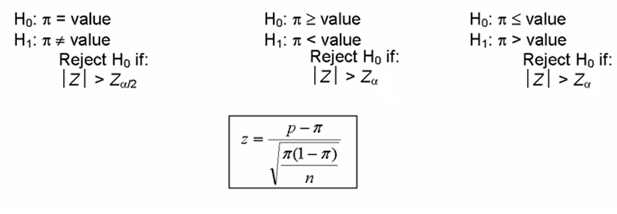
Hypothesis Setups for Testing a Mean (μ)
Hypothesis Testing
Tests Concerning Proportion
10-5

Slide 6
One-tail vs. Two-tail Test
Hypothesis Testing
10-6

Slide 7
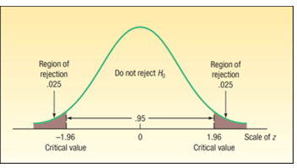
Hypothesis Testing
 | Dominos
Mean | 32
Variance | 40
N | 35
Std. error | 1.07
T-value | 1.87
H₀: µ_{D} = 30
H₁: µ_{D} ≠ 30
@ .10 level Z=1.645
@ .05 level Z=1.96
@ .01 level Z=2.33
$$Z=\frac{32−30}{\sqrt{\frac{40}{35}}}=\frac{2}{1.07}=1.87$$
$If \left|1.87\right|>Z, reject$ $H_{0}$

Slide 8
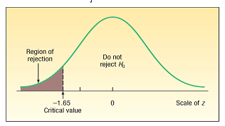
Hypothesis Testing
 | Dominos
Mean | 32
Variance | 40
N | 35
Std. error | 1.07
T-value | 1.87
H₀: µ_{D} ≤ 30
H₁: µ_{D} > 30
@ .05 level Z=1.645
$$Z=\frac{32−30}{\sqrt{\frac{40}{35}}}=\frac{2}{1.07}=1.87$$
$If \left|1.87\right|>Z, reject$ $H_{0}$

Slide 9
Hypothesis Testing
10-9

Slide 10
Hypothesis Testing
Problem: The waiting time for patients at local walk-in health clinic follows a normal distribution with a mean of 15 minutes and a population standard deviation of 5 minutes. The quality-assurance department found in a sample of 50 patients that the mean waiting time was 14.25 minutes. At the 0.025 significance level, decide if the sample data support the claim that the mean waiting time is less than 15 minutes. State your decision in terms of the null hypothesis.
z | 0.00 | 0.01 | 0.02 | 0.03 | 0.04 | 0.05 | 0.06 | 0.07 | 0.08 | 0.09
1.4 | 0.4192 | 0.4207 | 0.4222 | 0.4236 | 0.4251 | 0.4265 | 0.4279 | 0.4292 | 0.4306 | 0.4319
1.5 | 0.4332 | 0.4345 | 0.4357 | 0.4370 | 0.4382 | 0.4394 | 0.4406 | 0.4418 | 0.4429 | 0.4441
1.6 | 0.4452 | 0.4463 | 0.4474 | 0.4484 | 0.4495 | 0.4505 | 0.4515 | 0.4525 | 0.4535 | 0.4545
1.7 | 0.4554 | 0.4564 | 0.4573 | 0.4582 | 0.4591 | 0.4599 | 0.4608 | 0.4616 | 0.4625 | 0.4633
1.8 | 0.4641 | 0.4649 | 0.4656 | 0.4664 | 0.4671 | 0.4678 | 0.4686 | 0.4693 | 0.4699 | 0.4706
1.9 | 0.4713 | 0.4719 | 0.4726 | 0.4732 | 0.4738 | 0.4744 | 0.4750 | 0.4756 | 0.4761 | 0.4767
2.0 | 0.4772 | 0.4778 | 0.4783 | 0.4788 | 0.4793 | 0.4798 | 0.4803 | 0.4808 | 0.4812 | 0.4817
Notes:
fail to reject H_{o}: µ ≥ 15

Slide 11
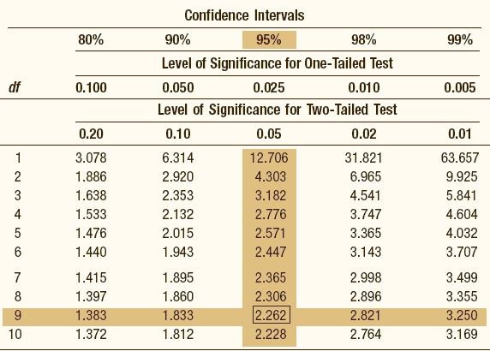
Hypothesis Testing
Problem: A manufacturer wants to increase the shelf life of a line of cake mixes. Past records indicate that the average shelf life of the mix is 216 days. After a revised mix has been developed, a sample of nine boxes of cake mix had a mean of 217.222 and a standard deviation of 1.2019. At the 0.025 significance level, decide if the sample data support the claim that shelf life has increased. State your decision in terms of the null hypothesis.
Notes:
reject H_{o}: µ ≤ 216

Slide 12
End

