Slide 1
Personal Finance
Bennie Waller
wallerbd@longwood.edu
434-395-2046
Longwood University 201 High Street Farmville, VA 23901

Slide 2
Consumer Loans

Slide 3
Consumer Loans
Loans are formal (legal) contracts with details as to the terms of the loan. Loans are generally used for larger purchases and are available.
Single-Payment (Balloon) loan – paid back in single lump payment at maturity. E.g., bridge loan
Installment loan – amount of loan is amortized over time with interest and principal paid each payment. Interest decreases over time.
Secured loan – guaranteed with collateral
Unsecured – no guarantee (signature loan)
Remember that taking on debt can get out of control. Borrow responsibly.

Slide 4
Variable or Fixed Rate Loan
Fixed-rate loan – rate is constant for the duration of the loan.
Variable-rate (Adjustable) loan – where interest rate charged varies based on some bench mark.
Adjustment period, cap rates, benchmark measures.
Typically lower interest rate because borrower is assuming interest rate risk.
Prime rate—the interest rate that banks charge to their best customers
Convertible loan – loan where a variable-rate loan can be converted to a fixed-rate.

Slide 5
Loan Durations
Shorter term loans - lower interest but larger payments
Longer term loans - smaller payments but higher interest rate

Slide 6
Terms of the loan
Security agreement – identifies if the lender will retain control over the purchased item.
Note – legal obligations of parties
Default – occurs when the borrower fails to make payment.
Acceleration clause – entire balance due if payment is missed.
Deficiency clause – in case of repossession, creditor has right to charge consumer the difference between what is owed and the proceeds from sale of asset.

Slide 7
Type of Loans
Home Equity Loan or Second Mortgage—secured loan using equity in home as collateral.
Generally has a lower interest rate and interest is tax deductible. However, there is risk in the sense that you could potentially loose your home if you default.
Student Loan – low interest rate loan for educational purposes based on financial need. Stafford loans are federal government loans made directly through financial aid offices. Plus loans made through private lenders (banks)
Automobile loans – are generally secured loans where the automobile acts as collateral. Loans durations vary.

Slide 8
Costs of Loans
APR—annual percentage rate - percentage cost of all finance charges over the life of the loan, on annual basis. In addition to interest other charges include loan processing fees, credit check fees, and any required insurance fees, etc.
Truth in Lending Act requires all consumer loan agreements disclose APR in bold print.

Slide 9
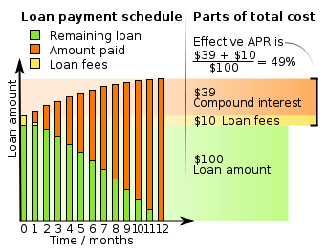
Calculation of APR

Slide 10
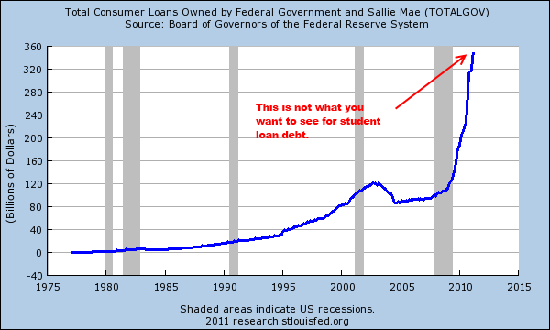
Student Loan Debt

Slide 11
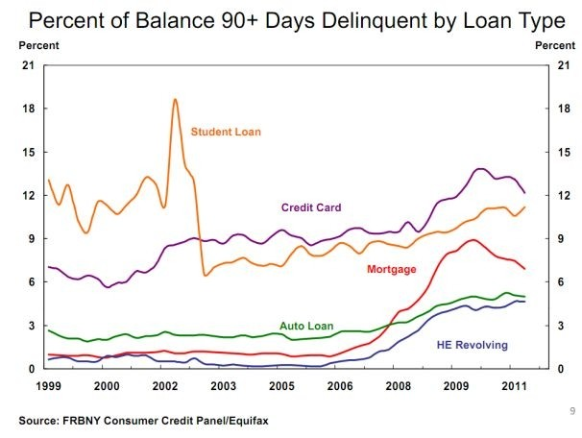
Delinquencies

Slide 12
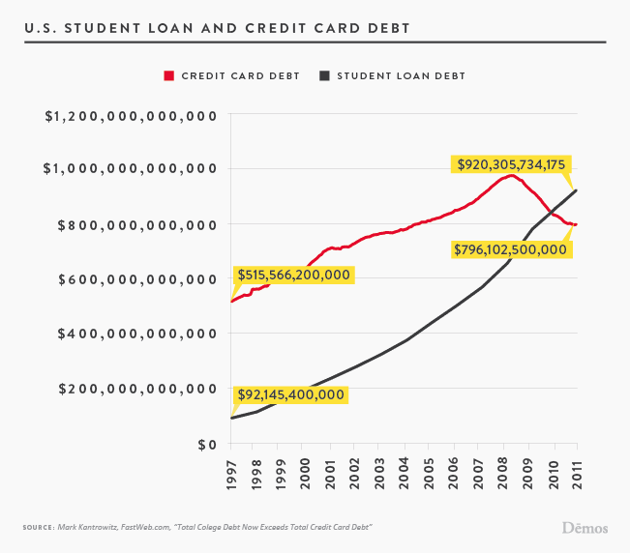
Student Loan and Credit Card Debt

Slide 13
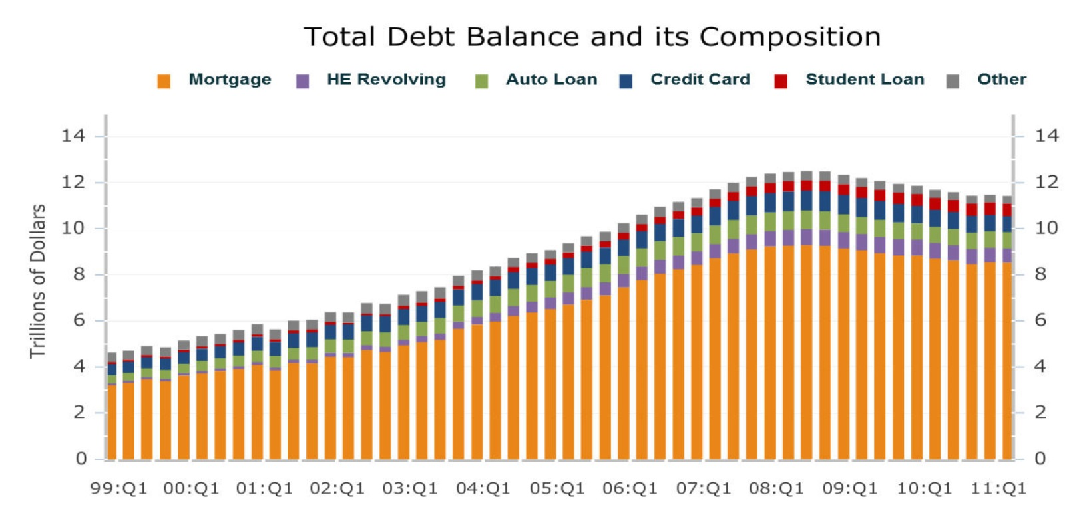
Total Debt

Slide 14
Loan Costs
Single-payment loans:
Loan disclosure statement gives APR and finance charges of a loan
Payday Loans are a very dangerous type of single payment loans
These short-term loans generally for several hundred dollars and typically due within 1-2 weeks.
Many times a check will be post-dated for repayment of principal and interest.
Annualized rates can be as much as 400%.

Slide 15
Payday Loan Facts
Payday lenders originate an estimated $27 billion in annual loan volume.
The typical two-week loan annual rates range from 391 to 521 percent.
The “churning” of existing borrowers’ loans every two weeks accounts for 75% of all payday loan volume.
Repeated payday loans result in $3.5 billion in fees each year.
90% of the payday lending business is generated by borrowers with five or more loans per year, and over 60% of business is generated by borrowers with 12 or more loans per year
Source: responsiblelending.org

Slide 16
Loan Costs
Single-payment loans:
Loan disclosure statement gives APR and finance charges of a loan
Simple interest method:
interest = principal x rate x time
Example: $1,000 borrowed at a rate of 10% for 9 months
1,000 x .10 x 9/12 = $75
Discount method – prepay interest
Example: $1,000 borrowed at a rate of 10% for 1 year. Interest charges would be $100. So the loan proceeds would actually be only $900
APR on this loan would be (100/900) = 11.1%

Slide 17
Loan Costs
Installment loans are loans where the payment is amortized overtime to a zero balance. Repayment of both interest and principal occurs at regular intervals.
Example of $2,000 loan with 6% rate amortized over 12 months.
Period | Beg. Balance | Payment | Principal | Interest | Ending Balance
1 | 2,000.00 | 172.13 | 162.13 | 10.00 | 1,837.87
2 | 1,837.87 | 172.13 | 162.94 | 9.19 | 1,674.92
3 | 1,674.92 | 172.13 | 163.76 | 8.37 | 1,511.17
4 | 1,511.17 | 172.13 | 164.58 | 7.56 | 1,346.59
5 | 1,346.59 | 172.13 | 165.40 | 6.73 | 1,181.19
6 | 1,181.19 | 172.13 | 166.23 | 5.91 | 1,014.96
7 | 1,014.96 | 172.13 | 167.06 | 5.07 | 847.90
8 | 847.90 | 172.13 | 167.89 | 4.24 | 680.01
9 | 680.01 | 172.13 | 168.73 | 3.40 | 511.28
10 | 511.28 | 172.13 | 169.58 | 2.56 | 341.70
11 | 341.70 | 172.13 | 170.42 | 1.71 | 171.28
12 | 171.28 | 172.13 | 171.28 | 0.86 | 0.00

Slide 18
Sources of loans
There are many sources of loans available. Some are better than others.
Traditional resources include commercial banks, S&Ls and Credit unions.
Finance companies and retail stores, but generally a higher rate
HELOC, borrowing against insurance policies are generally have better rates.

Slide 19
Shop around
Getting the best rate on your loan
Excellent credit is needed
Large down payments on “big” ticket items
Pledge collateral
Consider a variable rate loan

Slide 20
Questions to ask yourself???
Wants vs. Needs ?
Do I really need to make this purchase?
Would a less expensive option provide the same utility?
Should I save and make the purchase later?
Can I pay cash?

Slide 21
Being in charge
Controlling your debt –
Debt “limit” ratio – percent of take home pay committed to non-mortgage debt. This ratio should be below 15%. As this ratio increases you your capacity to borrow.
Most lenders use the 28/36% rule when considering mortgage applications
28% of Gross income for PITI
36% of Gross income for PITI and other liabilities

Slide 22
How to deal with financial difficulties
Develop and implement a budget that brings in more money than is going out. Pay off short-term debt with the highest interest rate first.
Develop self-control with credit use. Live within your means! Stop charging and building more debt.
Use savings to pay off current debt. This is an emergency measure and ignores the original purpose of savings—for future goal achievement.

Slide 23
How to deal with financial difficulties
Contact your creditor if you are unable to pay your bill
Get credit counseling from reputable organization
Debt consolidation loan
Bankruptcy as a last resort
Chapter 7 – straight bankruptcy eliminates most debts but not student loans, alimony/child support or taxes.
Chapter 13 – Wage earner plan where repayment schedule is devised by courts.

Slide 24
Thank You

