Slide 1
Statistics
Bennie Waller
wallerbd@longwood.edu
434-395-2046
Longwood University 201 High Street Farmville, VA 23901

Slide 2
Measures of Location and Dispersion

Slide 3
Measures of Location
KIDS
1
2
3
3
4
5
MEAN
MEDIAN
MODE

Slide 4
Measures of Dispersion
Most widely used measure of dispersion is variance and standard deviation.
Standard deviation measure the dispersion or volatility around a benchmark (mean or average)

Slide 5
Understanding Statistics
A
B

Slide 6
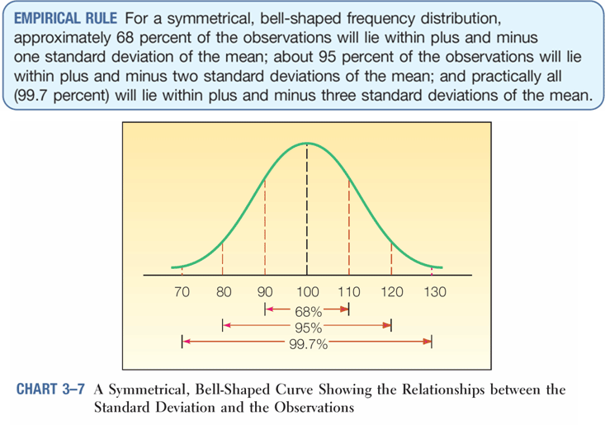
Measures of Dispersion

Slide 7
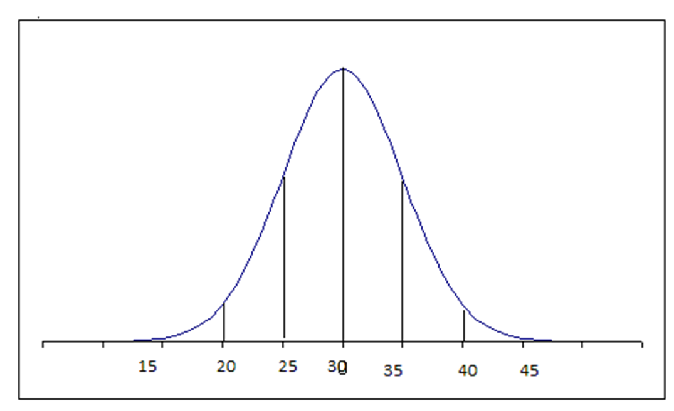
Empirical Rule

Slide 8
Empirical Rule

Slide 9
Empirical Rule

Slide 10
Variance/Standard Deviation
 | Class A | Class B
 | 95 | 79
 | 95 | 75
 | 90 | 78
 | 90 | 76
 | 15 | 77
Mean | 77 | 77
Range | 80 | 4
Variance | 966 | 2
Std Dev. | 31.08 | 1.41
$μ_{A}$=$\frac{95+95+90+90+15}{5}$ = 77
$σ^{2}=\frac{{(95−77}^{2})+({95−77)}^{2}+({90−77)}^{2}+({90−77)}^{2}+({15−77)}^{2}}{5}$=966
$σ$=$\sqrt{σ^{2 }}=31.08$

Slide 11
Variance

Slide 12
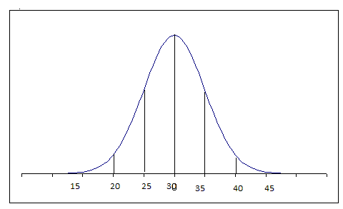
Empirical Rule
Consider an example of Pizza deliveries where the mean is 30 minutes with a standard deviation of 5 minutes. Using your knowledge of the empirical rule, what is the likelihood of a pizza arriving in;
<30 minutes?

Slide 13
Empirical Rule
Consider an example of Pizza deliveries where the mean is 30 minutes with a standard deviation of 5 minutes. Using your knowledge of the empirical rule, what is the likelihood of a pizza arriving in;
<20 minutes?

Slide 14
Empirical Rule
Consider an example of Pizza deliveries where the mean is 30 minutes with a standard deviation of 5 minutes. Using your knowledge of the empirical rule, what is the likelihood of a pizza arriving in;
>35 minutes?

Slide 15
End

