Slide 1
Statistics
Bennie Waller
wallerbd@longwood.edu
434-395-2046
Longwood University
201 High Street
Farmville, VA 23901

Slide 2
Probability

Slide 3
Probability
What is probability
  The likelihood of an event occurring
  0<=P(X)<=1

Slide 4
Probability
Classical Probability
Empirical Probability
Subjective Probability

Slide 5
Probability
Marginal Probability
Independence
Joint Probability
Mutually exclusive
Conditional Probability

Slide 6
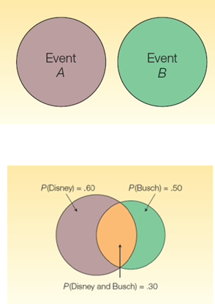
Probability
Rules of addition
P(A or B) = P(A) + P(B)
P(A or B) = P(A) + P(B) - P(A and B)

Slide 7
Probability
Rules of multiplication
P(A and B) = P(A)P(B)
P(A and B) = P(A)P(B|A)

Slide 8
Contingency Tables
Males
Females
Smokes
.30 | .05
.20 | .45
.35
Does not smoke
.65
.50
.50

Slide 9
Examples
Problem: A student is taking two courses, history and math. The probability that the student will pass the history class is .60 and the probability of passing the math class is .70. The probability of passing both is .50. What is the probability of passing at least one of the classes?

Slide 10
Problem: A study by the National Park Service revealed that 50% of the vacationers going to the Rocky Mountain region visit Yellowstone Park, 40% visit the Tetons and 35% visit both.
What is the probability that a vacationer will visit at least one of these magnificent attractions?
What is the .35 probability called?
Are these events mutually exclusive?
.50
.35
.40

Slide 11
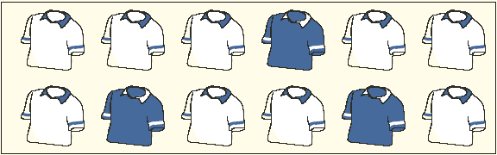
General Mutliplication Rule
A golfer has 12 golf shirts in his closet. Suppose 9 of these shirts are white and the others blue. He gets dressed in the dark, so he just grabs a shirt and puts it on. He plays golf two days in a row and does not do laundry.
What is the likelihood both shirts selected are white?
P(A and B) = P(A)*P(B|A)
Notes:
9/12*8/11=.55

Slide 12
Contingency Tables
In a survey of employee satisfaction, the following table summarizes the results in terms of employee satisfaction and gender.
What is the probability that an employee is Female and Dissatisfied?
What is the probability that an employee is Male or Dissatisfied?
What is the probability that an employee is Satisfied given that the employee is Male?

Slide 13
Problem: Airlines monitor the causes of flights arriving late. 75% of flights are late because of weather, 35% of flights are late because of ground operations. 15% of flights are late because of weather and ground operations. What is the probability that a flight arrives late because of weather or ground operations?
Notes:
.95 and .27

Slide 14
End

