Slide 1
Personal Finance
Bennie Waller
wallerbd@longwood.edu
434-395-2046
Longwood University 201 High Street Farmville, VA 23901

Slide 2
Consumer Decision-Making

Slide 3
Wants vs. Needs
When considering purchases, be sure to differentiate between “wants” and “needs”.
Needs – something thought to be a necessity or essential items required for life
Wants– something unnecessary but desired or items which increase quality of living

Slide 4
Questions to ask yourself???
Wants vs. Needs ?
Do I really need to make this purchase?
Would a less expensive option provide the same utility?
Should I save and make the purchase later?
Can I pay cash?

Slide 5
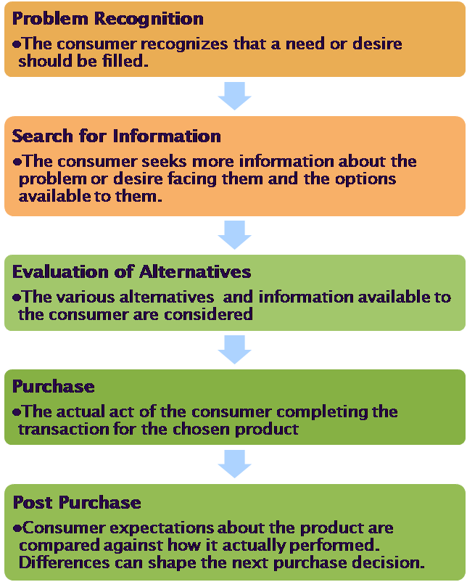
Decision making process

Slide 6
Initial vs. Repeat Purchases
Consumer Decision making
Initial purchases
Tend to require more extensive problem solving
Repeat purchases
Tend to require limited problem solving, sometimes habitual decisions

Slide 7
Post-purchase outcome
Outcomes
Actual product performance matches pre-purchase expectations
Neutral
Actual product performance exceeds pre-purchase expectations.
Satisfaction
Actual product performance is below pre-purchase expectations.
Dissatisfaction

Slide 8
A Continuum of Satisfaction
Degree of satisfaction
Dissatisfaction
Satisfaction
Delighted

Slide 9
If dissatisfied….
Alternative actions
Do nothing
Avoid seller/brand in the future
Negative WOM to friends
Seek redress of problem from seller
Complain to outside agency

Slide 10
Addressing problems
Is based on:
Level of dissatisfaction
Importance of decision/purchase
Costs/benefits of actions
Personal characteristics
Attribution of blame

Slide 11
Filing a complaint
Depending on the type of complaint
Better business bureau
Scope of organization
National vs. local
Retail organization
Financial institutions
Federal reserve
Office of the Comptroller of the currency

Slide 12
Addressing problems
Keep a record of all communications
First contact the individual/firm from whom you purchased the asset.
Next, contact the company. Larger companies have a department for such issues.
If by phone, don’t be emotional. State the facts calmly. Don’t make threats.
If in writing, send either an email or registered letter to ensure you have a record.
File a complaint with regulating authorities or organizations such as the BBB.
Lawsuit

Slide 13
Consumer protection
The FTC’s Bureau of Consumer Protection is tasked with dealing with unfair, deceptive or fraudulent practices in the marketplace.
http://www.ftc.gov/bcp/consumer.shtm
The organization conducts investigations, sues companies and people that violate the law, develop rules to ensure a vibrant marketplace, and educate consumers and businesses about their rights and responsibilities.
They collect complaints concerning a wide range of issues from data security and deceptive advertising to identity theft and Do Not Call violations.

Slide 14
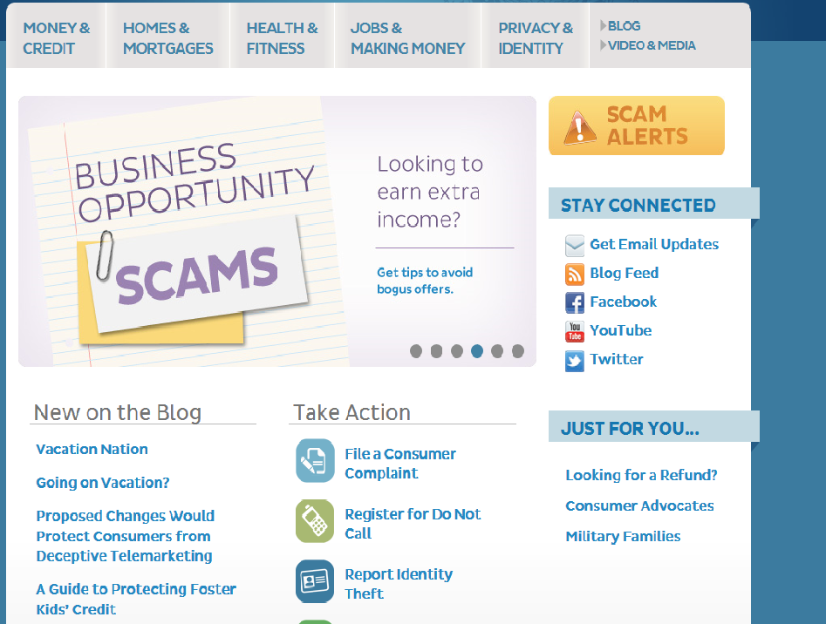
www.consumer.ftc.gov

Slide 15
Contracts
A necessary evil in today’s society
Cell phone
Internet usage agreements
Leases
Mortgages
Automobiles
Pest control

Slide 16
Contracts
Elements of a contract
Offer and acceptance
Intent
Consideration
Capacity
Consent
Offer and acceptance –
Offer – expression to willingness to enter into a contract on a specific set of terms
Acceptance – absolute agreement to terms
Counter-offer

Slide 17
Intention
Parties must intend to enter into an agreement
Consideration
Something of value must be offered.
Capacity
Consent
Willingly entered into contract

Slide 18
Statute of frauds – requires that certain contracts must be in writing to be enforceable.
E.g., contracts involving real property
Right of rescission (“cooling off” period) – refers to the right of a person who has three days after signing loan papers to change their mind about the loan.

Slide 19
Final word on contracts
If it is a major event/purchase – get a lawyer
Read it. Don’t show up at broker’s office and just sign your life away.
Get it in writing – contracts can be rewritten
Never sign anything that you don’t completely understand and are comfortable.
Always keep a copy for your records.

Slide 20
Thank You

