Slide 1
Personal Finance
Bennie Waller
wallerbd@longwood.edu
434-395-2046
Longwood University 201 High Street Farmville, VA 23901

Slide 2
Credit Cards

Slide 3
Credit Cards
Know how credit cards work.
Understand the costs of credit.
Describe the different types of credit cards.
Know what determines your credit card worthiness and how to secure a credit card.
Manage your credit cards and open credit.

Slide 4
Credit Cards
Credit is the concept of buying now and paying later.
Credit cards are a source of open credit where the cardholder has been approved for a line of credit.
Unpaid balances (and accrued interest) carries over the next month.
Credit cards are convenient, but if you’re not careful, they can ruin your financially.
Some charge up to 30% interest on unpaid balances.
Manage credit wisely to avoid high interest.

Slide 5
Benefits of credit cards
Convenience of shopping in person, by phone, or over the Internet, without the risk of carrying cash.
Availability of a temporary source of emergency funds.
Use of the good, service, or cash before it’s fully paid for.
Convenience of a complete, itemized bill for a month’s worth of shopping.
Opportunity to buy a needed item before an anticipated price increase.

Slide 6
Benefits of credit cards
Interest-free use of funds, for cards with a grace period, from date of purchase to payment.
Convenience of making reservations or guaranteeing reservations for late arrival.
Form of identification.
Availability of a variety of free benefits.

Slide 7
Disadvantages of credit cards
Loss of spending control.
High interest charges for unpaid balances.
Credit repayment commits future income and limits financial flexibility.

Slide 8
Cost associated with credit cards
An annual fee for use of card.
Over 70% of biggest credit card issuers do not charge an annual fee
A merchant’s discount fee is typically a fixed percent of sales paid by merchant.
Over 70% of biggest credit card issuers do not charge an annual fee
Late fees.
Over-the-limit fees.
A penalty rate is a higher interest rate assessed on your account if the minimum payment is not paid on time. This rate may be applied in addition to the late payment fee.

Slide 9
Calculation of interest charges
Credit card issuers use three balance calculation methods:
Average daily balance method, as the name implies, is the average of the daily balances divided by the number of days in the billing period. Some include new purchases, others do not.
Previous balance method bases the interest calculation on the balance at the end of the previous billing cycle, ignoring both payments and charges made during the current cycle.
Adjusted balance method bases the interest calculation on the balance at the end of the previous billing cycle after deducting payments during the current cycle.

Slide 10
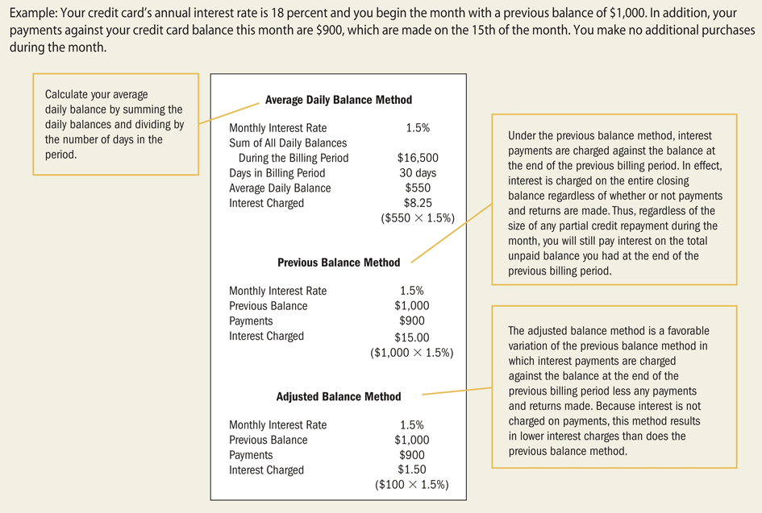
Calculating Interest on Balance Owed

Slide 11
Cash Advances
Cash advances at ATMs are just like taking out a loan.
Higher interest rate charged immediately on cash advances
Up-front fee of 2-4% of the amount advanced.

Slide 12
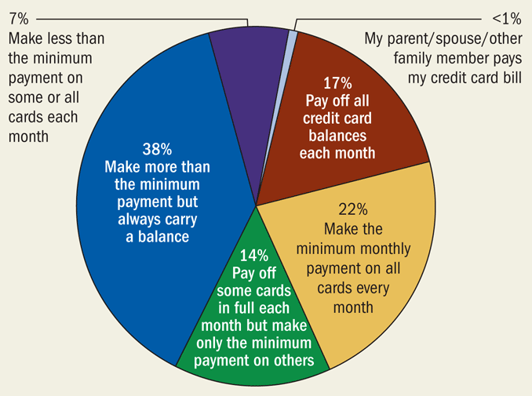
Undergraduates and credit cards

Slide 13
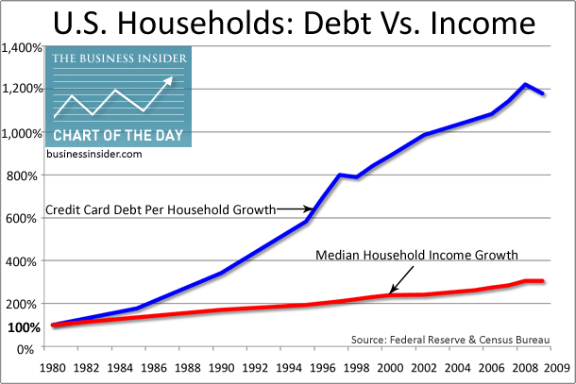
Disadvantages of credit cards

Slide 14
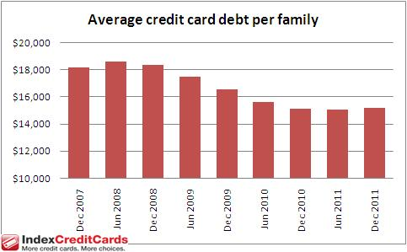
Disadvantages of credit cards

Slide 15
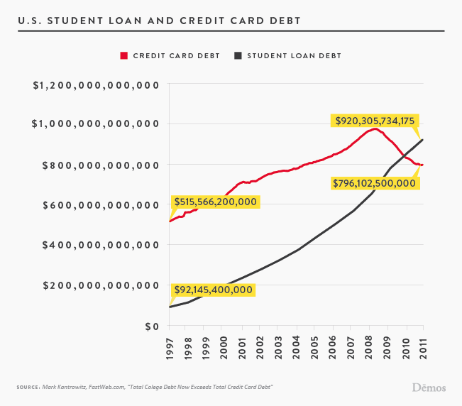
Disadvantages of credit cards

Slide 16
Card Act of 2009
Credit card companies must provide at least 45 days notice before increasing interest rates, changing fees, terms, or other significant changes.
Credit card companies must disclose how long it will take to pay off an outstanding balance.
Credit card companies can no longer increase interest rates during the first 12 months after an account is opened. Although, if you are 60 days late in the credit card bill the rate can be increased.
Increased interest rates apply only to new charges.
You must “Opt-in” if you wish to allow transactions that take you over your credit limit. If you have not given permission, and the charge does go through, the credit card may not charge penalties or additional fees.

Slide 17
Card Act of 2009
Most consumers under age 21 will require a co-signer in order to open a credit card account or show document that their income is high enough to qualify for credit.
Credit card companies must now mail or deliver credit card statements at least 21 days before a payment is due.
Payments exceeding minimum due must be applied to balances with the highest rate.
Credit card companies are no longer allowed to charge inactivity fees.

Slide 18
Grace periods
A grace period is the amount of time from the date of the bill during which interest is not charged on the outstanding balance which ranges from 22-25 days. In some instances, there is no grace period :
Approximately 25% of cards have no grace period.
For most all cards, there is no grace period for cash advances.
For accounts carrying a balance from the previous month, no grace period is allowed for current purchases—most all cards.

Slide 19
Types of cards
A premium card, an affinity card, and a secured card are all variations of a bank credit card.
A bank credit card is issued by a bank or large corporation, in cooperation with the Visa or MasterCard. Visa or MasterCard provide the system for credit authorization, billing, and advertising, while the issuing bank sets the terms of the card. Bank credit cards may be characterized by the following:
The credit limit of the cardholder is referenced through the four-level card class system. Very high credit limits and additional benefits rebates characterize a premium card, such as a Platinum or Titanium card.
An affinity card benefits the issuing organization or charity through a rebate of a small part of the annual fee or a percentage of the annual purchase amount.
A secured credit card is bank issued and backed by collateral, such as a CD or a savings account.

Slide 20
Travel and Entertainment cards
T&E cards require full payment each month while bank cards offer revolving credit, or the option to pay the balance over a period of time.
The only consumer advantage is the interest-free grace period, but a high annual fee is a disadvantage.
Single purpose cards can only be used for purchases at the issuing company (e.g., Exxon Mobil), unlike a bank card that can be accepted at a variety of business establishments around the world.

Slide 21
Traditional charge accounts
Traditional charge account—can be used to make purchases or get services only at the issuing company such as utility companies and doctors who provide services and bill later.
Convenient for both issuer and payee.
Pay monthly bill in full or pay interest/fee.

Slide 22
What type is best for you?
Credit user—carries an unpaid balance from month to month.
Convenience user—pays off the credit card balance each month (avoids interest).
Convenience and credit user—generally pays off all the balance

Slide 23
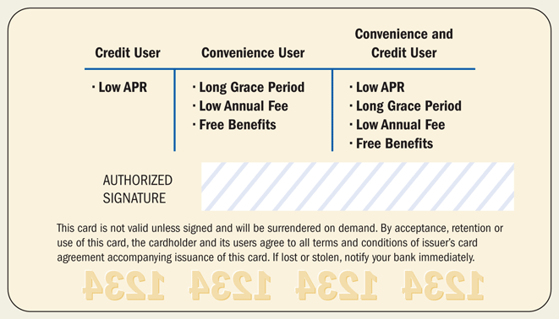
What type is best for you?

Slide 24
Getting a Credit Card
Excellent idea for students.
Emergency funds.
Build solid credit history if used prudently.
First step is to apply.

Slide 25
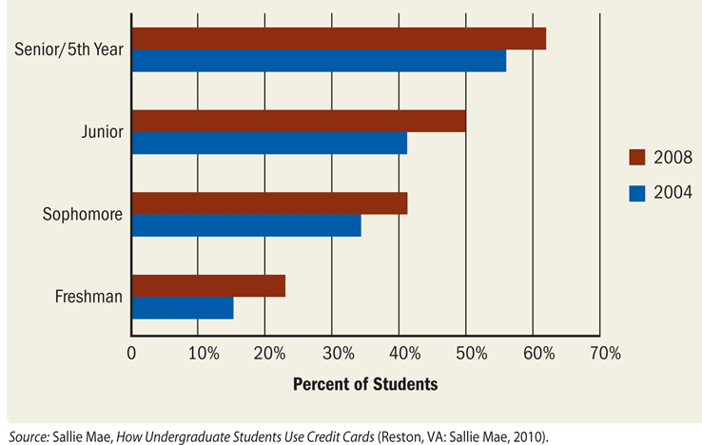
Student credit card debt

Slide 26
Be very careful of promotions
If it sounds too good to be true? Be careful when accepting promotional offers!
Home improvement store promotions
$10,000 would take approximately 30 years to payoff

Slide 27
Credit Card warning signs
Warning signs of credit card abuse
Paying only the minimum monthly payment each month.
Reaching, or exceeding, the maximum limit on cards.
Charging group expenses in exchange for the cash paid by others.
Using credit cards for impulse purchases as well as necessities such as food, rent, or other credit payments.
Getting cash advances to cover expenses when your checking account runs low.
Being turned down for a new credit card or having an old card canceled.
Failing to know how much interest you are accumulating on the account, or how the interest affects your monthly bill.

Slide 28
Strategies
Strategies for dealing with excessive credit card use:
Planning a budget for paying off credit card
Making no additional purchases on card
Shopping for the least expensive credit card that best meets your usage habits.
Using savings to pay off the credit card balance—only if it is cost effective and does not become a habit.
Using a secured loan or home equity loan to pay off credit card debt.

Slide 29
The 5 “Cs” of creditworthiness
The “five Cs” of credit to determine creditworthiness include:
Character: reflects stability in your lifestyle.
Capacity: reflects the relationship between earnings and debt.
Capital: reflects the level of savings and investments held.
Collateral: reflects the availability of assets for security, should you default on the loan.
Conditions: reflect the possible impact the current economic situation.

Slide 30
Understanding your credit
Credit bureaus collect, maintain, and provide information to lenders. The three major bureaus are Experian, Equifax and Transunion which provide and/or confirm information to lenders. Such information includes your address, employment, and credit history.
Credit scores are also provided and typically are based on models developed by Fair Isaac Corporation, hence the name FICO score.
The higher the score, the greater the availability of credit and the lower the interest rates charged. With lower scores, interest rates increase and at some predetermined score, credit is denied.

Slide 31
What’s in Your Credit Report
Identifying Information
Trade Lines or Credit Accounts
Inquiries
Public Record and Collection Items

Slide 32
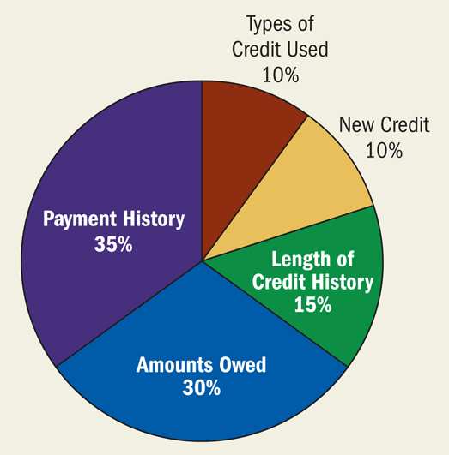
What drives your score?

Slide 33
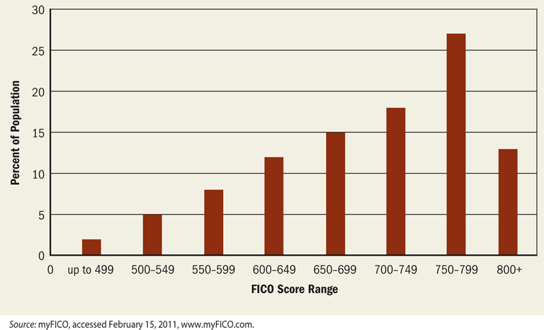
FICO ranges

Slide 34
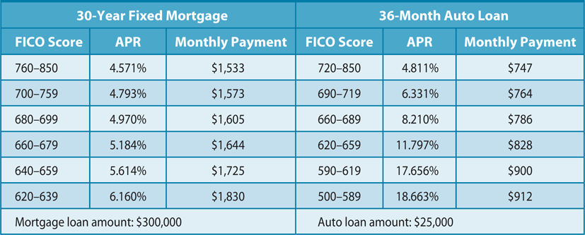
Payments based on FICO scores
1,533 x 360 = $551,880
1,830 x 360 = $658,800
Difference of $106,920

Slide 35
Monitoring your credit
Check your credit report annually.
www.annualcreditreport.com
Check all information and report any errors immediately.
If you are denied credit based on your credit report, you can request a free copy of your report (FCRA, 1996).
File a statement to explain negative information that is accurate, not corrected.
FCRA—negative information remains on report for 7 to 10 years.

Slide 36
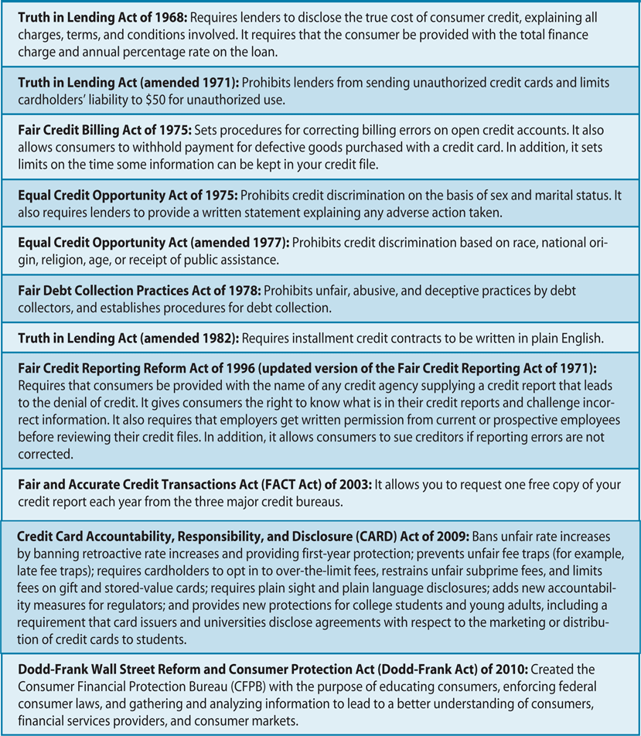
Sources of Consumer Credit Information

Slide 37
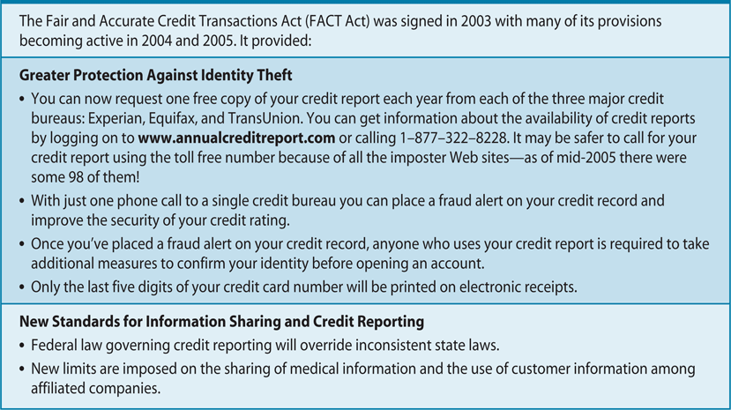
Fair and Accurate Credit Transactions Act (FACT)

Slide 38
Credit Bureaus and Your Rights
FACTA—you can request one free copy for your credit report from national bureaus and contact them for inaccuracies.
Bureau must investigate and correct.
File a statement to explain negative information that is accurate, not corrected.
FCRA—negative information remains on report for 7 to 10 years.

Slide 39
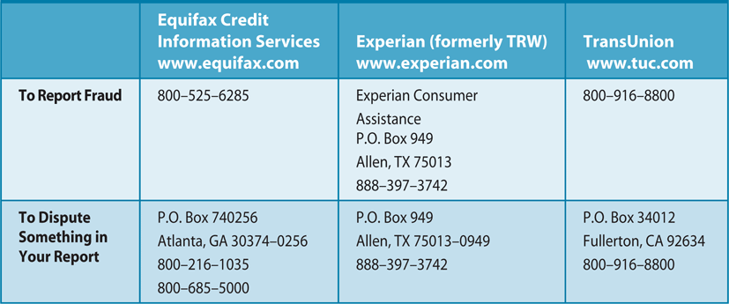
Credit Bureaus and Your Rights

Slide 40
Identity theft
You cannot use any identifying information of others without their knowledge.
You may have been a victim of Identity Theft if you receive unsolicited credit cards, are denied credit get calls from debt collectors.
If you feel you have been a victim of Identity Theft, put a fraud alert on your credit file by contacting credit agencies, police and file report with the FTC. Immediately close accounts that have been tampered with or ones you did not open.

Slide 41
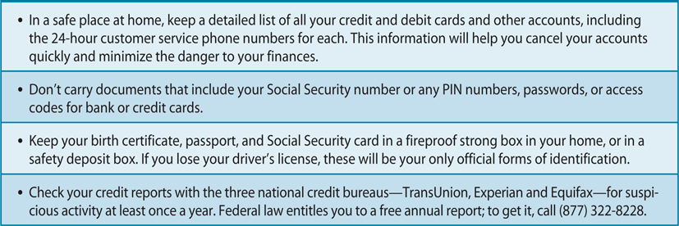
How to Prevent Identity theft

Slide 42
Thank You

