Slide 1
Personal Finance
Bennie Waller
wallerbd@longwood.edu
434-395-2046
Longwood University 201 High Street Farmville, VA 23901

Slide 2
Time Value of Money

Slide 3
Time Value of Money
Time Value of Money – is the idea that money available at the present is worth more than the same amount in the future.
This is due to its potential earning capacity. This core principle of finance holds that, provided money can earn interest, any amount of money is worth more the sooner it is received.
Which would you rather have -- $100 today or $100 in 1 year?
Money received sooner rather than later allows one to use the funds for investment or consumption purposes.
NOT having the opportunity to earn interest on money is called OPPORTUNITY COST.

Slide 4
Time Value of Money
TODAY
1 YEAR
$100
OPTIONS: CONSUMPTION OR INVESTMENT

Slide 5
Time Value of Money
Future Value of a current lump sum –
Present Value of a future lump sum -
TODAY
1 YEAR
$100
TODAY
1 YEAR
$100

Slide 6
Time Value of Money
Future value of an annuity –
Present value of an future annuity -
TODAY
YEAR 1
YEAR 2
YEAR 3
$100
$100
$100
TODAY
YEAR 1
YEAR 2
YEAR 3
$100
$100
$100

Slide 7
Time Value of Money
VARIABLES USED IN TVM CALCULATIONS
PV – Present Value
FV – Future Value
PMT – Payment
i – interest rate
N – number of time periods

Slide 8
Time Value of Money
Present Value of a lump sum
$$PV=\frac{FV}{{(1+i)}^{N}}=\frac{100}{{(1+.10)}^{1}}=\frac{100}{{(1.1)}^{1}}=90.91$$
$$PV=\frac{FV}{{(1+i)}^{N}}=\frac{100}{{(1+.05)}^{1}}=\frac{100}{{(1.05)}^{1}}=95.24$$
$$PV=\frac{FV}{{(1+i)}^{N}}=\frac{100}{{(1+.02)}^{1}}=\frac{100}{{(1.02)}^{1}}=98.04$$

Slide 9
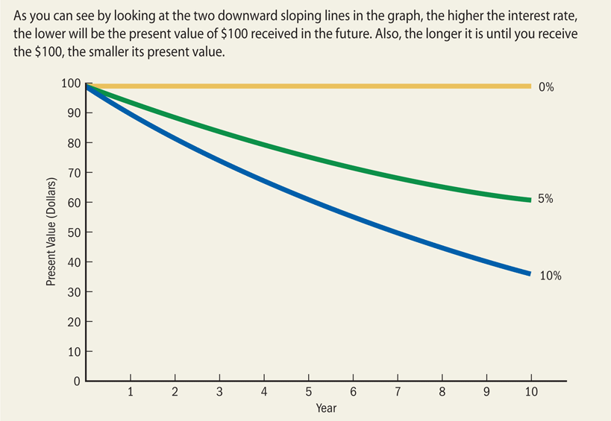
Time Value of Money

Slide 10
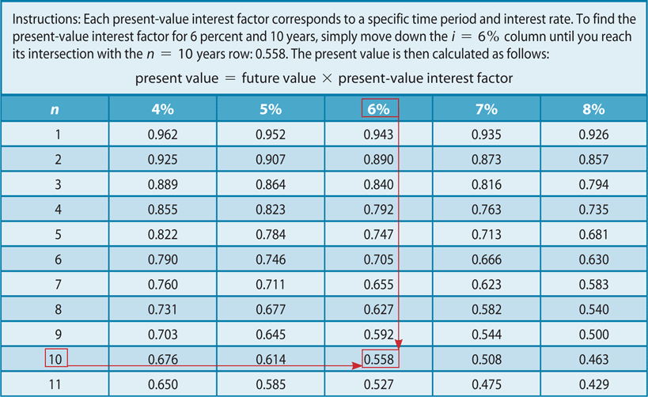
Time Value of Money
Present Value of $1

Slide 11
Time Value of Money
How much would you be willing to pay for an investment today based on some amount of money to be received in the future? It should depend on the riskiness of the investment or the certainty that you will receive the monies in the future.
Consider an investment expected to return $1,000 at the end of three years. Let’s first compare the amount you would be willing to pay if you required a 6%?

Slide 12
Time Value of Money
Suppose a firm is offered an investment that is expected to return $1,000 at the end of three years. Now let’s consider the 10% return?

Slide 13
Time Value of Money
Let’s consider the differences in these two values based on a 6% required return versus a 10% required return?

Slide 14
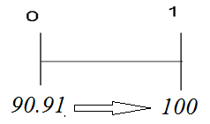
Time Value of Money
Future value of a lump sum
$$FV=PV{(1+i)}^{N}=90.91{(1+.10)}^{1}=100$$
$FV=PV{(1+i)}^{N}=100{(1+.10)}^{1}=110$
$FV=PV{(1+i)}^{N}=100{(1+.05)}^{1}=105$
$FV=PV{(1+i)}^{N}=100{(1+.02)}^{1}=102$

Slide 15
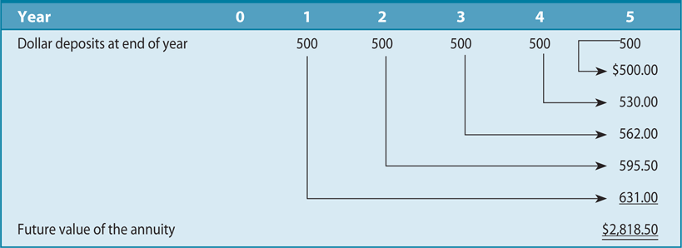
Time Value of Money
Annuity – a series of equal dollar payments coming at the end of each time period for a specific number of periods.
You can determine how much your savings will be worth at some point in the future (graduation from college) or a more long-term focus of retirement

Slide 16
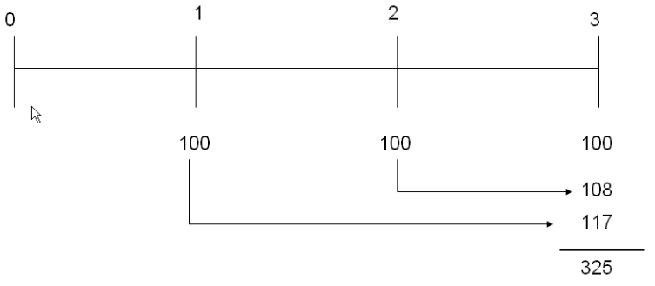
Time Value of Money
Future Value of an annuity - You deposit $100 at the end of each year in a savings account that pay 8% compounded annually. How much is the investment worth at the end of 3 years?

Slide 17
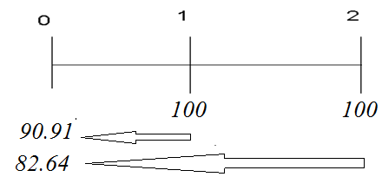
Time Value of Money
Present value of an annuity
$$PV=\sum{\frac{FV}{{(1+i)}^{N}}}=\frac{100}{{(1+.10)}^{1}}+\frac{100}{{(1+.10)}^{2}}=\frac{100}{{(1.1)}^{1}}+\frac{100}{{(1.1)}^{2}}=90.91+82.64=173.55$$

Slide 18
Time Value of Money
Present value of an annuity

Slide 19
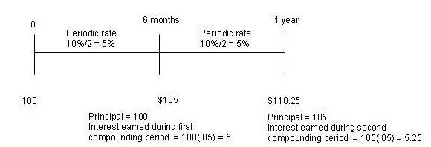
Time Value of Money
Simple Interest - Interest earned on principal only
Compound Interest - Interest paid (earned) on any previous interest earned, as well as on the principal borrowed (loaned).
Another example

Slide 20
Time Value of Money
Assume a 10% rate compounded quarterly.
Today
3 months
6 months
9 months
1 year
$1
$1 X $.025
= $1.025
$1.025 X $.025
= $1.050625
$1.025 X $.025
= $1.076891
$1.025 X $.025
= $1.103813

Slide 21
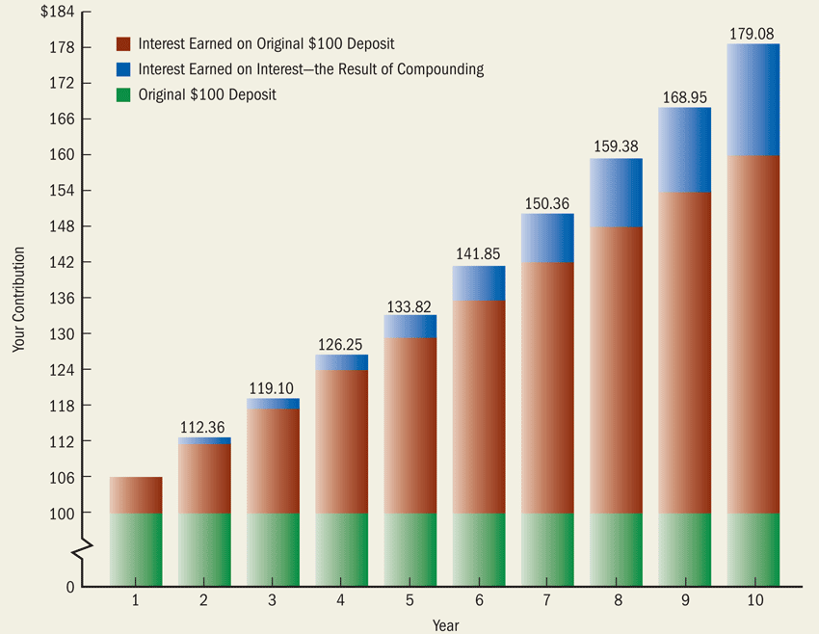
Compound Interest at 6 Percent Over Time

Slide 22
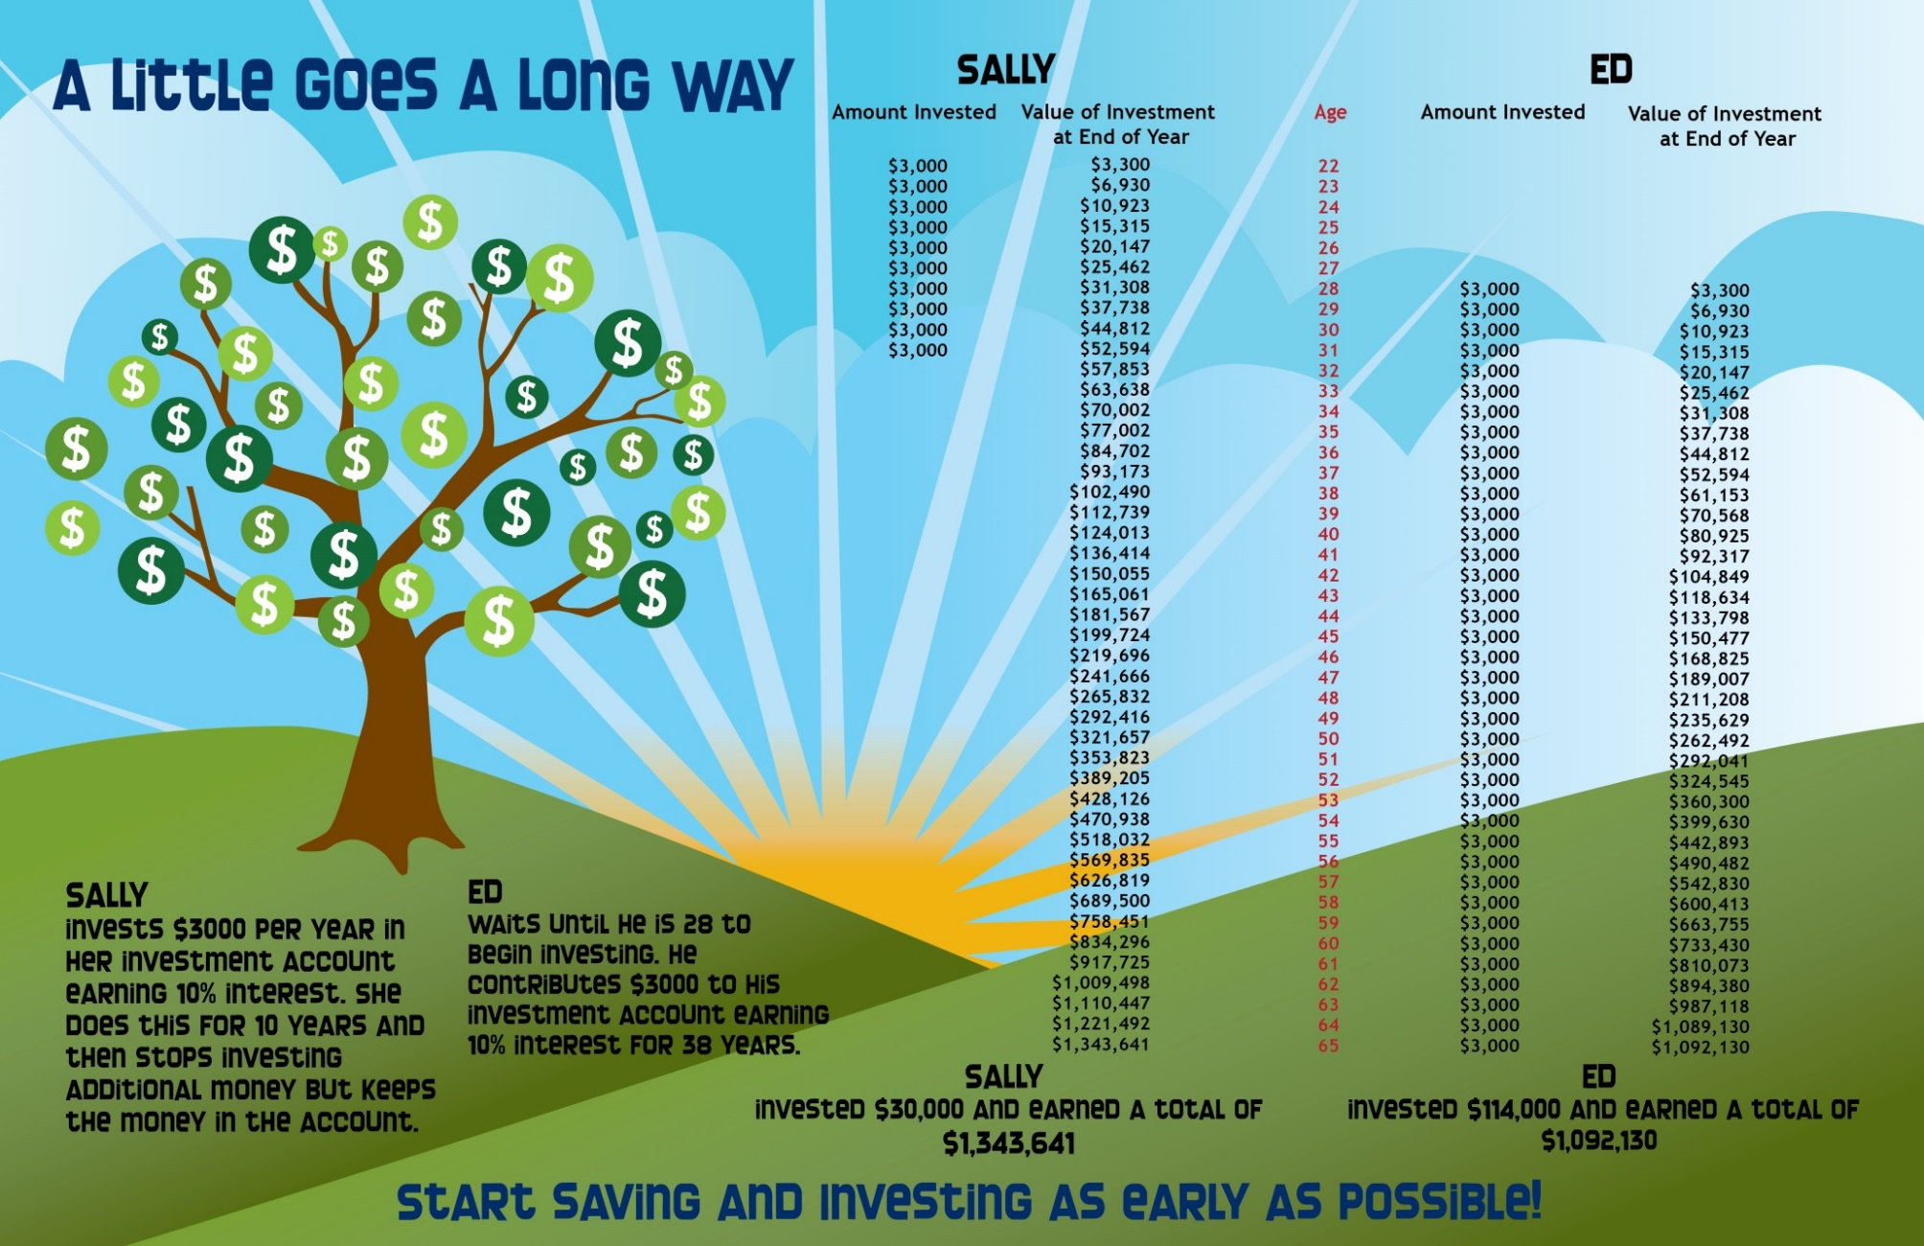
Compound Interest at 6 Percent Over Time

Slide 23
The Rule of 72
How long will it take to double your money?
Numbers of years for a given sum to double by dividing the investment’s annual growth or interest rate into 72.
Example: If an investment grows at an annual rate of 9% per year, then it should take 72/9 = 8 years.

Slide 24
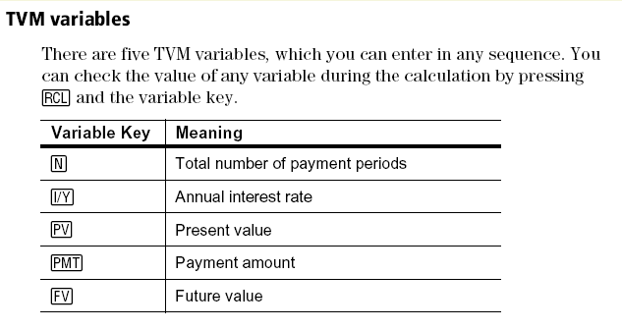
Time Value of Money
BA II PLUS Calculator

Slide 25
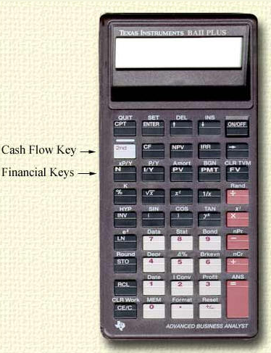
Calculator
ENTER key
Compute (CPT) Key
Payment key
Present Value key
Future Value key
I/Y = interest rate
N =number of periods
CE/C Clear key
Source: wikipedia.com

Slide 26
Time Value of Money
Learning how to use a financial calculator to make present value calculations can help you decide whether you should accept a cash rebate, 0% financing on the purchase of a car or to pay discounts points on a mortgage.

Slide 27
Time Value of Money
HINT on organizing results
FV =
PV =
N =
I =
PMT=

Slide 28
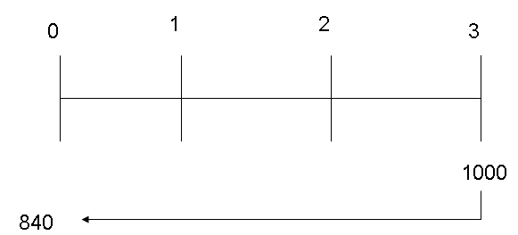
Time Value of Money
Example: Suppose a firm is offered an investment that is expected to return $1,000 at the end of three years. How much is it willing to pay for this offer if the firm's required return is 6%?
Calculator example

Slide 29
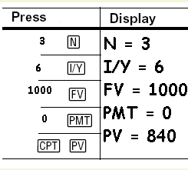
Time Value of Money
Calculator Solution
Financial Formula Solution
$$PV=\frac{{FV}_{n}}{{(1+i)}^{n}}=\frac{1000}{{(1+.06)}^{3}}=840$$

Slide 30
Time Value of Money
PV =
FV =
N =
I =
PMT=

Slide 31
Time Value of Money
Present Value of an Annuity – The present value of an annuity is finding the present value of a series of fixed payments at a given rate of interest.
Example: If you were to win the lottery worth $1 million to be paid out over the next 20 years at $50,000 per year. Assuming a discount rate of 20%, how much is the $1 million worth today?
Probably not as much as you think.
Let’s see

Slide 32
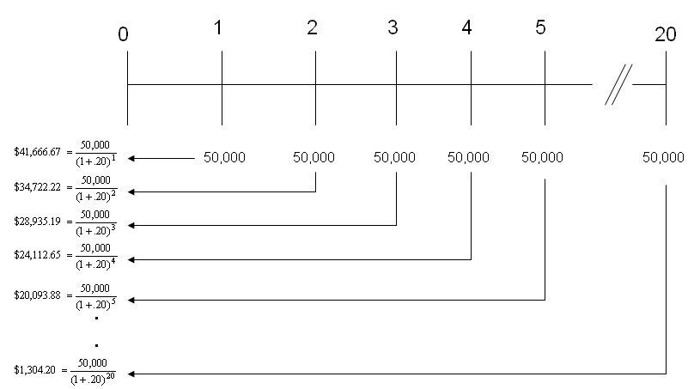
Time Value of Money
Present Value of an Annuity –
$243,479

Slide 33
Time Value of Money
Present Value of an Annuity –
Example: If you were to win the lottery worth $1 million to be paid out over the next 20 years at $50,000 per year. Assuming a discount rate of 20%, how much is the $1 million worth today?
Financial Formula Solution
$PV=CF∗[\frac{1−{(1+i)}^{−n}}{i}$]
PV=50,000*[$\frac{1−{(1+.20)}^{20}}{.20}$]=243,479

Slide 34
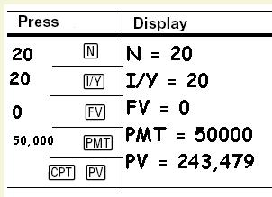
Time Value of Money
Calculator Solution

Slide 35
Time Value of Money
Example: If you were to win the lottery worth $1 million to be paid out over the next 20 years at $50,000 per year. Assuming that your opportunity costs is 15%, how much is the $1 million worth today?
PV = 312,967
FV = 0
N = 20
I = 15
PMT= 50,000

Slide 36
Time Value of Money
Future Value of a lump sum – represents what a given amount of money will be worth at some point in the future given some rate of interest.
If you are financially prudent, you would prefer $100 today since you could invest it in an interest earning asset such as a savings account and your investment would grow to something greater than the original value.

Slide 37
Time Value of Money
Example: The graphic below illustrates that $100 invested today at a 10% rate with annual compounding will be worth $110 at the end of 1 year. The $110 is composed of the original principal of $100 and interest of $10.
That is if you as an investor were to place $100 in a savings account earning 10%, it will be worth $110 at the end of 1 year.

Slide 38
Time Value of Money
Example: The graphic below illustrates that $100 invested today at a 10% rate with annual compounding will be worth $110 at the end of 1 year. The $110 is composed of the original principal of $100 and interest of $10.
That is if you as an investor were to place $100 in a savings account earning 10%, it will be worth $110 at the end of 1 year.
Financial Formula Solution
F$V=PV∗{(1+i)}^{n}$
FV= 100*${(1+.10)}^{1}=110$

Slide 39
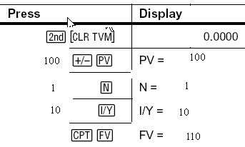
Time Value of Money
Calculator Solution

Slide 40
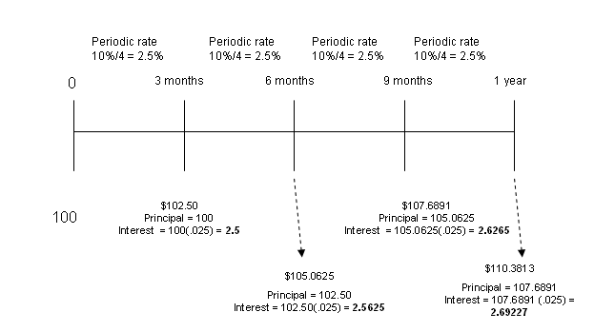
Time Value of Money
Future Value - Example: The following examples illustrates future value of $100 invested for 1 year at a 10% rate compound quarterly.

Slide 41
Time Value of Money
Future Value - Example: The following examples illustrates future value of $100 invested for 1 year at a 10% rate compound quarterly.
Financial Formula Solution
F$V=PV∗{(1+i)}^{n}$
FV= 100*$(1+\frac{.10}{4})^{4}=110.3813$

Slide 42
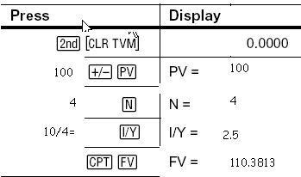
Time Value of Money
Calculator Solution

Slide 43
Time Value of Money
Future Value of an Annuity - an annuity (or ordinary annuity as it is often referred) is a series of equal cash flows. This would be the case if each year on your birthday, your parents deposited into a saving account a fixed amount of money (say $100).
Example

Slide 44
Time Value of Money
Future Value of an annuity - You deposit $100 at the end of each year in a savings account that pay 8% compounded annually. How much is the investment worth at the end of 3 years?

Slide 45
Time Value of Money
Future Value of an annuity - You deposit $100 at the end of each year in a savings account that pay 8% compounded annually. How much is the investment worth at the end of 3 years?
Financial Formula Solution
F$V=CF∗[\frac{{(1+i)}^{n}−1}{i}$]
FV=100*[$\frac{{(1+.08)}^{3}}{.08}$] = $325

Slide 46
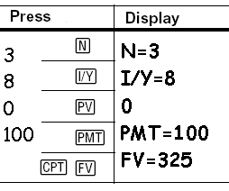
Time Value of Money
Calculator Solution

Slide 47
Time Value of Money
Effective Interest Rates - The nominal interest rate is different than the effective interest rate. Why? Because, of the compounding effect.
Example: You decide to put $100 in a savings account that earns 5% annually, but interest is compounded on a monthly basis, what is your effective rate?
Let’s see

Slide 48
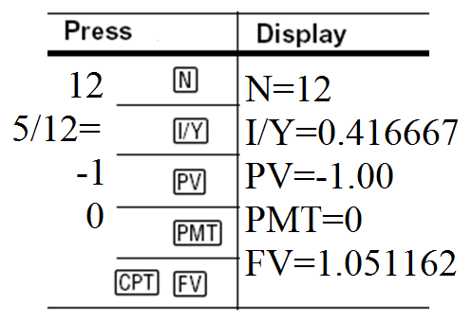
Time Value of Money
Example: You decide to put $100 in a savings account that earns 5% annually, but interest is compounded on a monthly basis, what is your effective rate?

Slide 49
Time Value of Money
Effective rate example: If your credit card charges an annual rate of 18% put interest is compounded monthly, what is the effective rate?
FV = ?
PV = 1
N = 12
I = 18/12
PMT= 0

Slide 50
Time Value of Money
FV = 1.1956
Effective Rate = 1.1956 – 1 = .1956
Effective Rate = .1956

Slide 51
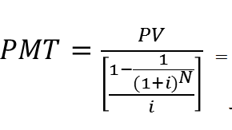
Time Value of Money
Amortized Loans
Loans paid off in equal installments such as a car or home. Consider a $100,000 mortgage financed at a 6% annual rate for 30 years with monthly payments***.
Financial Formula Solution
$599.55

Slide 52
Time Value of Money
Again, consider a $100,000 financed at a 6% annual rate with monthly amortization for 30 years.
PMT =
PV =
FV =
I =
N =

Slide 53
Time Value of Money
We will consider many examples in more depth when we cover consumer loans which includes mortgages and car loans.

Slide 54
Time Value of Money
Perpetuities
A perpetuity is an annuity that pays a constant payment forever.
Present value of a perpetuity = annual dollar amount provided by the perpetuity divided by the annual interest rate.
$PV=\frac{PMT}{i}$

Slide 55
Time Value of Money
Perpetuities
Assume that you want to leave a gift to your alma mater that will provide an scholarship in the amount of $5,000. Given an annual interest rate of 4%, how much would you need to donate to provide such a scholarship?
$PV=\frac{PMT}{i}$

Slide 56
Thank You

