Slide 1
Chapter 13:
Contracts for Sale
and Closing

Slide 2
Contract for Sale: The Most Important Document in Real Estate?
Determines price and terms of the transaction
Defines property interest being conveyed
Determines the grantee
Determines other conditions of the transaction
  Financing
  Date of occupancy
  Any repairs or other conditions of the sale

Slide 3
Required Elements of a Contract
All contracts:
  Competent parties
  Legal objective
  Offer and acceptance
  Consideration
  No defects to mutual assent
Contract for sale of real estate:
  In writing (per Statute of Frauds)
  Proper description of property

Slide 4
A Closer Look at Requirements
Competent parties
  Of legal age
  Not incapacitated at time of signing
  Appropriate official if representing a corporation
  Power of attorney if acting for another person
Lawful intent
Offer and acceptance
Consideration
No defects to mutual assent
  Fraud
  Gross error
  Duress or menace
In writing
Legal Description should be used

Slide 5
Legal vs. Equitable Title
Legal title: Ownership of a freehold estate
Equitable title: Right to obtain legal title
Buyer obtains equitable title when a contract for sale of real estate is fully signed

Slide 6
Would This Be a Valid Contract?
I, Ben Buyer, agree to buy and pay $20,000, and I, Cecil Celler,
Agree to sell the parcel of real estate at 1013 NE Seventh Road
in North Platte, Nebraska.
Ben Buyer:
Cecil Celler
Competent parties?
Legal objective?
Offer and acceptance?
Consideration?
Defects to mutual assent?
In writing?
Valid description?

Slide 7
Problems with This Contract?
I, Ben Buyer, agree to buy and pay $20,000, and I, Cecil Celler, Agree to sell the parcel of real estate at 1013 NE Seventh Road In North Platte, Nebraska.
Ben Buyer:
Cecil Celler
What are boundaries of 1013 NE Seventh Road?
When is the closing?
When does Ben get possession?
Cash sale? Earnest money deposit?
Must Cecil deliver marketable title?
Is a quitclaim deed acceptable?
Any fixtures (e.g., fences?)
Is Cecil married?
Are there structures? Condition now? Condition at closing?

Slide 8
Advantages of Form Contracts
Neutral (not prepared by opposite party)
Ready-made treatment of details
  Prorations
  Inspections
  Performance dates
  Many others
Local real estate boards are a good source
  Up-to-date with current relevant law
  Adapted to locally important issues
    Radon risk Flood plain
    Insulation quality Water supply
  Generally neutral between the buyer and seller

Slide 9
Risks with Standard Form Contracts
May treat some issues too lightly
  Perpetual struggle on contract detail
    Attorneys: More detail reduces future disputes
    Brokers: Long contracts put a chill on negotiations
    Resolution: Bar Assn.-Realtors jointly drafted contract form
Inappropriate and inadequate application of a form contract, examples:
  Residential contract for apartment property
  Residential contract for undeveloped land

Slide 10
Components of a Form Contract
Part I: Points particular to the deal
  Items to be negotiated (price, date of closing, distribution of expenses)
  Items that characterize the property (water source, zoning, flood zone status)
Part II: Items that must be clear (the same for most transactions)
  Provisions for survey
  Proration procedure
  Disbursement of funds
  Recourses in case of default

Slide 11
Handling of Funds
Broker normally handles funds for a transaction
Broker must put deposits in escrow
  Escrow account: An account holding funds dedicated for a particular purpose
  Typically must be with insured institution or title company
At closing, money is disbursed in accordance with a closing statement

Slide 12
Contract Terminology
Contingent contract: Obligation of a party to perform depends on one or more conditions being met
Assignment: One party’s contractual rights and obligations are transferred to someone else
  Does not relieve assignor of liability
  Can be explicitly prohibited

Slide 13
Contract Terminology (continued)
Escrow agent: Third party who holds moneys or documents on behalf of contract parties
  Distributes items in accordance with contract
  Can be attorney, financial institution, or title company

Slide 14
Remedies of Buyer and Seller
Suit for damages: Always an option to both parties
Specific performance: Buyer can force seller to convey title
Liquidated damages: Seller can retain deposit if buyer backs out
Rescission: Mutual agreement to cancel

Slide 15
Roles of Brokers and Lender in the Transaction
Selling broker: No legal role after contract is signed; facilitator for buyer
Listing broker:
  May handle closing if no lender is involved
  May assist in retaining services for seller
Lender:
  Requirements
  Often handles closing

Slide 16
Financial Items in a Closing: Conventional Payers
Purchase price
Earnest money deposit
Assumed mortgage
Purchase money mtg.
Prorated Items
Interest on assumed mtg.
Existing insurance
Property taxes
Buyer pays
Buyer has prepaid
Buyer takes over from seller
Seller loans to buyer
Buyer pays, receives credit
Seller paid, receives credit
Buyer pays, receives credit

Slide 17
Financial Items in a Closing (continued)
Title insurance – owner’s
Title insurance – lender’s
Attorney – buyer
Attorney – seller
State doc. tax – Mtg.
State doc. tax – Deed
Intangibles tax – Mtg.
Recording of new mtg.
Recording of deed
Brokerage commission
Paid by seller
Paid by buyer
Paid by buyer
Paid by seller
Paid by buyer
Generally paid by seller
Paid by buyer
Paid by buyer
Paid by buyer
Paid by seller

Slide 18
Proration – Property Tax: Example
Closing date: May 14 (365-day year)
  Annual property tax: $500
Seller’s days
Buyer’s days
133 days
232 days
Jan. 1
May 14
Dec. 31
Seller’s share of tax:
133
^{x} $500 = $182.19
365

Slide 19
Proration of Insurance: Example
Closing date: March 16 (365 day year)
  Prepaid Insurance: Dec. 15 to Dec. 14,
  $250 per year
Seller’s days
Buyer’s days
91 days
274 days
Dec. 15
Mar. 16
Dec. 14
Buyer’s share of insurance:
274
^{x} $250 = $187.67
365

Slide 20
Laws Affecting a Residential Closing
TILA (Truth in Lending Act)
RESPA (Real Estate Settlement Procedures Act)
Dodd-Frank (D-F Wall Street Reform and Consumer Protection Act)

Slide 21
From RESPA
Law applies to virtually every home loan:
  Loans from federally chartered or insured institutions.
  FHA and VA loans
  Loans to be sold to Fannie Mae or Freddie Mac
In practice, resulting forms and procedures are used for nearly all home closings

Slide 22
From RESPA
Required disclosures and notices
Required information booklet
Required loan costs estimate
Required closing statement
Prohibition of “kickbacks” to lenders
Limits on required escrow deposits

Slide 23
From RESPA and Dodd-Frank
Lender must provide borrower with:
  Information booklet on home borrowing: CFPB website –Your home loan toolkit: a step-by-step guide
  Loan Estimate of closing costs within 3 days of loan application
  Closing Disclosure (closing statement) 3 business days before closing
Other requirements:
  Must use the Closing Disclosure form
  Kickbacks to supporting vendors prohibited
  Limit to lender escrow deposit requirements

Slide 24
Loan Estimate
Incorporates:
  RESPA loan closing cost disclosures
  TILA disclosures
  TILA requirement of APR
Loan Estimate Explainer | Consumer Financial Protection Bureau

Slide 25
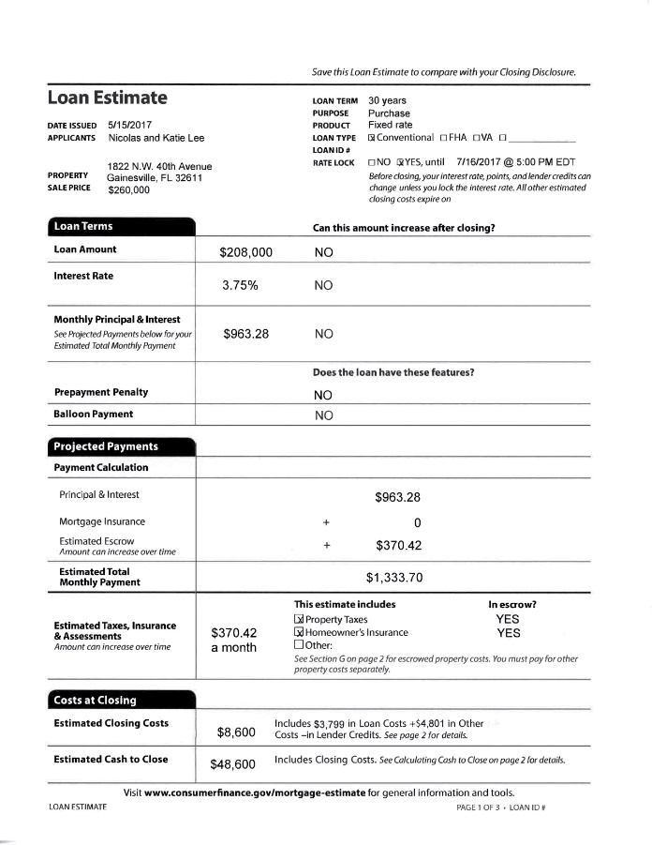
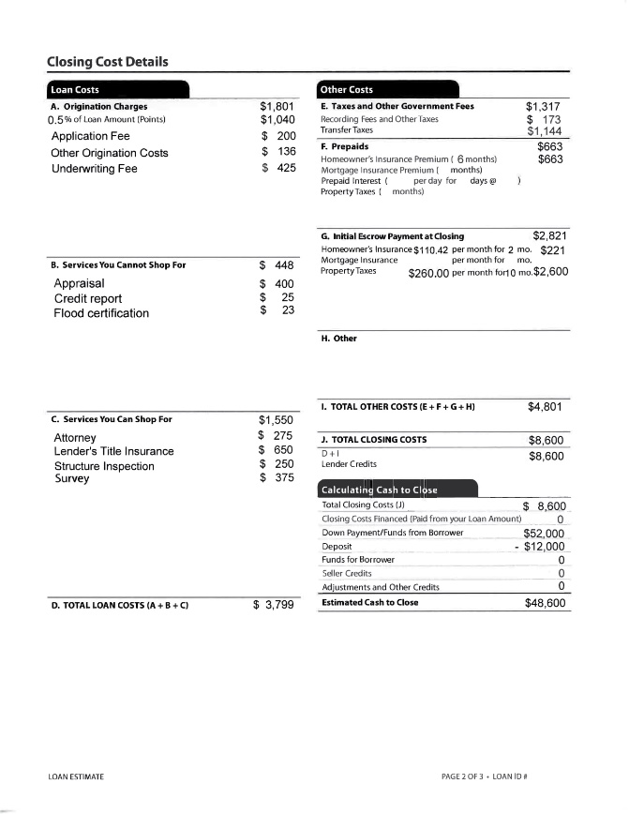
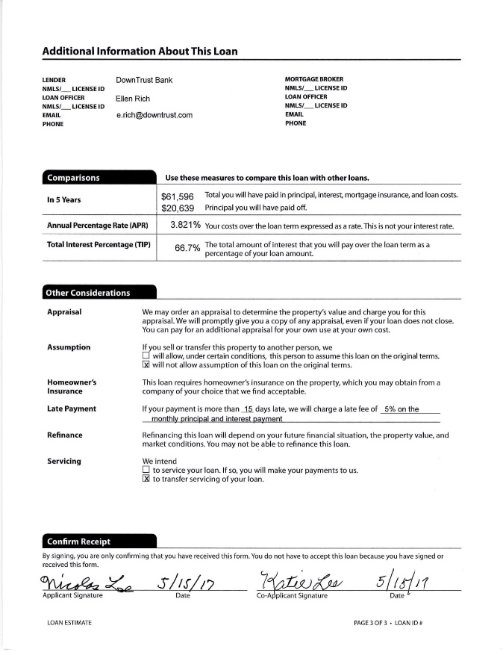
CFPB Loan Estimate

Slide 26


Slide 27
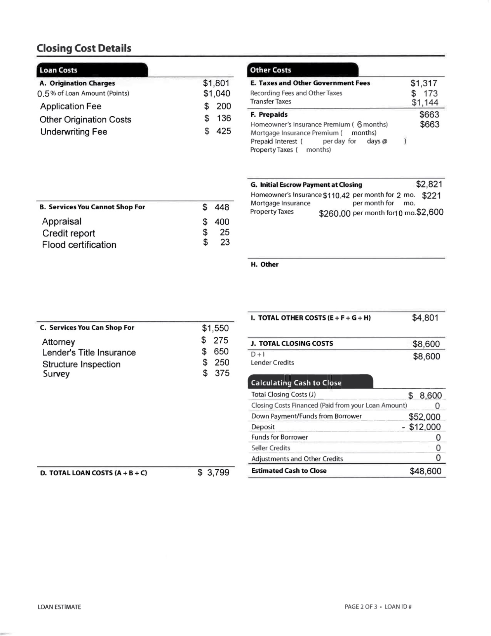

Slide 28


Slide 29
Preclosing Steps of Buyers (Joneses)
Had property surveyed for encroachments
Reviewed private restrictions for violations
Reviewed zoning for neighborhood
Examined estimated closing costs
Ordered lenders title insurance
Had property inspected
Verified that seller has performed required tasks
Arranged utility service transfers

Slide 30
Preclosing Steps of Sellers (Johnsons)
Order owner’s title policy
Order termite inspection
Order discontinuation of hazard insurance and utilities

Slide 31
Preclosing Steps of Closing Agent (Lender)
Prepare or obtain general warranty deed
Prepare mortgage and note
Prepare check from lender to the seller
Prepare Loan Disclosure closing statement
Obtain satisfaction of mortgage from sellers’ mortgagee confirming balance

Slide 32
CFPB Closing Disclosure

Slide 33
CFPB Closing Disclosure
Combines disclosure requirements from RESPA with “truth-in-lending” disclosures from TILA
https://www.consumerfinance.gov/owning-a-home/closing-disclosure/

Slide 34
Page 2: Detailed Expenses
Origination charges
Services you did not shop for
Services you can shop for
Government fees
Prepaids
Escrow payments at closing
Other

Slide 35
Page 3 Closing Disclosure
Estimated Cash to Close from LE

Slide 36
Page 3 Closing Disclosure
Total Due
Due from Borrower

Slide 37
Page 3 Closing Disclosure
Total Due: K
Total Paid Already: L
Paid Already for Borrower

Slide 38
Page 3 Closing Disclosure
Total Due: K
Total Paid Already: L
Difference: K minus L

Slide 39
Page 3 Closing Disclosure
Buyer/Borrower’s Computations

Slide 40
Page 3 Closing Disclosure
Seller’s Computations

Slide 41
Page 3 Closing Disclosure
Total Due to Seller: M
Total Due from Seller: N
Difference: M minus N

Slide 42
Final Points on Closing and Closing Costs
The buyer’s expenses at closing are significant, and can exceed 5 percent of the purchase price.
While custom frequently determines what fees the buyer and seller incur, the arrangements are negotiable.
The CFPB Closing Disclosure is now the standard format for creating a home closing statement

Slide 43
End of Chapter 13

