Slide 1
Chapter 16:
Commercial Mortgage Types and Decisions

Slide 2
“Commercial” Mortgage Loans vs. Home Loans
Commercial mortgages & notes for existing properties not as standardized as home loans
Documents are longer & more complex
Often no personal liability:
Legal borrower often is a single asset entity (usually a LLC or LP)
Shields sponsor from personal liability unless he/she provides other guarantees
“Passive” investors always shielded from personal liability

Slide 3
When Do We See Recourse Loans?
On construction loans…almost always!
On permanent financing, nonrecourse loans dominate pension fund, life company, & CMBS loans
But…commercial banks may require some form of credit “enhancement”
Often a guarantee by organizer/sponsor of investment
to make lender whole in event lender suffers a capital loss on loan

Slide 4
When Do We See Recourse Loans?
Many lenders also unwilling to relieve borrowers of personal liability if a “willful” act of borrower causes a capital loss for lender
Examples: borrower fraud, environmental problems, unpaid property tax obligations
How is this accomplished?
A “carve-out” clause is often included in note
This “bad boy” clause holds borrower(s) personally liable for lender losses caused by such problems

Slide 5
Fixed Rate Commercial Mortgage Loans
Usually a partially amortized “balloon” mortgage
25-30 year amortization of principle
5-10 year loan maturity
Balance of loan at maturity must be
refinanced or
paid off with a “balloon” payment

Slide 6
Attractions of a Balloon Mortgage to Lender
Reduces interest rate risk on “permanent” mortgages
Reduces default risk
Default risk is generally much greater for commercial mortgage loans than home loans
Often no personal liability
No FHA/PMI insurance (as in home mtg. market)
Borrowers are more “ruthless” about exercising their default options than home owners
When is borrower’s default option “in-the-money”?

Slide 7
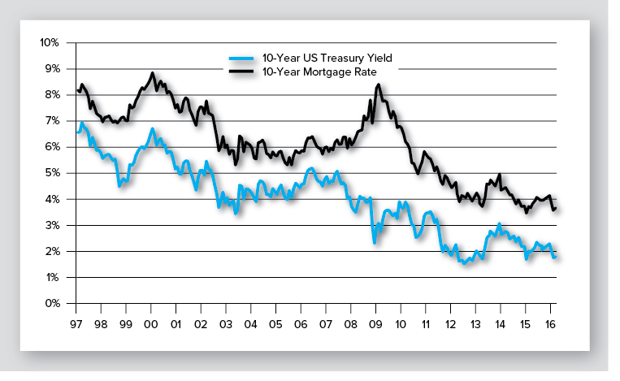
Commercial Mortgage “Spreads” over Treasuries
Exhibit 16-2
CRE mortgages are “priced off the yield curve” with rates quoted as spreads
Source: H-15 report of the Federal Reserve and the Giliberto-Levey Commercial Performance Index (www.jblevyco.com)
Correlation between monthly rates/yields on 10-yr mortgages & 10-yr Treasury securities: 0.85 from 1997-2016

Slide 8
Restrictions on Prepayment
Lock-out: Prohibition against prepayment for up to, say, 5 years
Prepayment penalties:
Percentage of loan: Say, 2-4% of loan balance
Used by commercial banks & other portfolio lenders
Yield maintenance penalty: Borrower must pay lender PV of losses due to prepayment
Primarily used by life insurance companies

Slide 9
Restrictions on Prepayment
Prepayment penalties, continued:
Defeasance penalty: Borrower must replace mortgage loan with a set of U.S. Treasury securities that produce CFs equivalent to those on paid-off mortgage
Most common form of prepayment penalty on loans used for collateral in CMBS
see www.defeasance.com for a defeasance calculator

Slide 10
Other Forms of Permanent Financing for Existing Properties
Floating (i.e., adjustable) rate mortgage
Rate changes periodically based on ∆s in index rate
Index rate is typically LIBOR, but may be “prime” rate or other short-term benchmark rate
Commercial banks most commonly provide floating rate loans
Better matches the maturity of their real estate assets with the maturities of their liabilities

Slide 11
Other Forms of Permanent Financing for Existing Properties
Sale-leaseback
Owner-user (bank, restaurant, drug store, etc.) sells property to long-term RE investor such as a
pension fund
limited liability company
REIT
User then leases property back from the investor(s) & occupies it under a long-term net lease

Slide 12
Sale-Leaseback (continued)
Benefits to original owner (now tenant):
Lease payment is deductible for income taxes
Capital from sale can be invested in core business of company
Investor benefits:
Can be relatively safe investment (depending on credit worthiness of tenant)
Often long term triple-net leases to “credit” tenants

Slide 13
2nd Mortgages & Mezzanine Loans
Supplements underlying first mtg. loan
Sometimes is a 2nd mortgage loan
i.e., secured by property
More often is a non-mortgage loan secured by a pledge of borrowers’ ownership interest(s) in entity
If borrower defaults, mezz lender takes over borrower’s ownership position
May give them more control…can negotiate with first lien holder

Slide 14
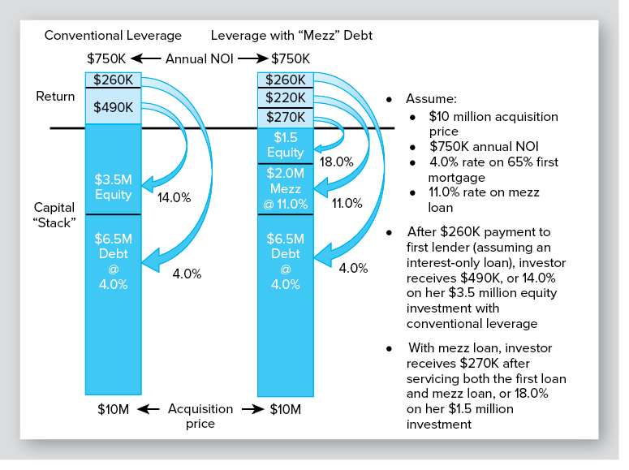
Adding a Mezzanine Loan or 2nd Mortgage to the “Capital Stack”
Exhibit 16-3
Interest-only loan
Interest-only loan

Slide 15
Adding a Mezzanine Loan or 2nd Mortgage to the “Capital Stack”
Exhibit 16-3
Interest-only loan
Interest-only loan
Weighted average cost of debt
= (6.5/8.5)x0.04 + (2.0/8.5)x0.11
=0.0564 or 5.6%
which is < 7.5% cap rate
Why does increased leverage in this example increase expected first year return on equity?

Slide 16
Mezzanine Lending
Is more expensive than 1st mortgage loan
But…may be less expensive than raising additional equity capital
And…sponsor keeps a larger % of equity ownership
Mezz lenders include:
private equity funds
off-shore investors
insurance companies, and
pension funds

Slide 17
Other Forms of Permanent Financing for Existing Properties
FHA insured loans for investment in low & moderate income multifamily housing www.hud.gov/local/shared/working/localpo/xmfhsgprograms.cfm?state=ak
Freddie Mac & Fannie Mae multifamily lending programs
Many targeted to low & moderate income housing
See Fannie & Freddie websites (www.fanniemae.com and www.freddiemac.com)

Slide 18
Underwriting Ratios Used by CRE Lenders

Slide 19
Debt Coverage Ratio
Indicator of “cash flow cushion” from lender’s perspective
where:
NOI₁ is first year (next 12 months) NOI
DS is annual debt service (monthly payment x 12)
Lender’s want DCR to be as high as possible, but typically 1.20 or higher
$$DCR= \frac{{NOI}_{1}}{DS}$$

Slide 20
Loan-to-Value Ratio
An indicator of borrower’s incentive to maintain the loan (i.e., not default)
Higher initial LTVs increase the probability of subsequent default, all else equal
Typical maximum LTV at origination is 75%
Mezzanine & second loans can increase leverage
$$LTV= \frac{Loan Amount}{Acquisition Price}$$

Slide 21
Debt Yield Ratio
Indicator of lender’s mortgage “return”
Cash-on-cash return lender would enjoy if it foreclosed & took title to property on day of loan origination
Does not consider contract interest rate or amortization period
DYR only considers how large loan is relative to property's NOI
Typical minimum DYR is 9.0% or higher
$$DYR= \frac{{NOI}_{1}}{Loan Amount}$$

Slide 22
Typical Terms on CRE Mortgages: ( Exhibit 16-1)
(Minimum)
(Maximum)
(Maximum)
(Maximum)
*From Ted Starkey at Wells Fargo

Slide 23
Borrower’s Decision Making Process: Loan Size
Reasons for use of debt by investors:
Limited financial resources/accumulated wealth
Debt alters risk & equity return of investment
“Magnifies” rate of return on invested equity
This magnification known as positive (or negative) leverage
Diversify investment portfolio

Slide 24
When is Use of Leverage Expected to be Favorable?
Increased leverage will increase expected return when….
the rate of return without leverage exceeds the cost of debt

Slide 25
Borrower’s Decision Making Process (continued)
Financial risk:
Risk that NOI will be insufficient to cover (“service”) the mortgage payment obligation
This negative cash flow may lead to default & foreclosure
This risk increases with leverage
Leverage also increases variability of equity returns (more on this in Chapter 19)

Slide 26
Borrower’s Decision Making Process: Refinancing
Refinancing involves a NPV decision
Even more focused on NPV than home mortgage refinancing
More sophisticated borrowers
Fewer non-financial considerations

Slide 27
Borrower’s Decision Making Process: Refinancing (continued)
Must account for lockout periods and/or prepayment penalty
NPV = PV of payment savings – Refi Cost – Prepay Penalty
Should discount monthly savings at current market mortgage rate
Expected holding period after refinancing is important assumption

Slide 28
Borrower’s Decision Making Process: Default
For lenders, default is the signature risk of commercial mortgages
Borrower seldom can cover for long the loan payment for a crippled commercial property
Loan is often (effectively) non-recourse (good for borrower, bad for lender)

Slide 29
Permanent Loan Application & Approval Process
Borrowers seeking to acquire or refinance an existing CRE property may submit loan requests directly to
commercial banks
life insurance companies, or
other direct lenders

Slide 30
Permanent Loan Application and Approval Process
Another channel for loan requests is through mortgage bankers & brokers
Mortgage brokers specialize in putting together loan application packages that meet requirements of both borrowers and lenders
They also assist borrowers in assembling the loan submission package
For these services, mortgage brokers receive a fee at loan closing that may range from 1/2 to 1 percent of loan amount

Slide 31
Permanent Loan Application and Approval Process
Relative to home loans, underwriting process for commercial loans is more complicated & more focused on property used as collateral for the loan
Primary reason?
Payments on commercial RE loans are expected to come from income generated by property
Result? The commercial loan underwriting process focuses first on the property being pledged as collateral for loan

Slide 32
Permanent Loan Application and Approval Process
Borrowers, perhaps aided by mortgage broker, submit a loan package to a lender (or lenders)
Purpose of loan submission package (executive summary)?
Provide lenders with information needed to quickly evaluate request
Package typically contains information on:
type, size, and location of property
maps and photographs
property age
purchase price
requested loan amount and other basic loan terms
recent operating history of property
current rent roll, and
estimated PGI over next twelve months

Slide 33
Permanent Loan Application and Approval Process
Based on loan submission package and, perhaps, conversations with borrower or borrower’s broker, lender either (1) rejects loan or (2) issues preliminary quote
Quote
contains basic terms of proposed loan
is sometimes referred to as a letter of intent (LOI)
Borrower then choses to reject or accept quote
Or, in some cases, attempt to negotiate better loan terms

Slide 34
Permanent Loan Application and Approval Process
If lender & borrower are able to agree on the basic loan terms
lender will finalize loan application
which is then signed by borrower

Slide 35
Permanent Loan Application and Approval Process
Length & details of loan application vary with
size of loan request
type of property being used as collateral (e.g., office, apartment)
whether loan will be held in lender’s portfolio or sold in secondary market to be used as collateral for the issuance of a CMBS
Loan applications typically contains a great deal of terms & language that will be included in final promissory note/mortgage

Slide 36
Permanent Loan Application and Approval Process
When application is signed, borrower typically pays a non-refundable loan processing fee to cover lender expenses
Fee is usually modest, often < $5,000 even on loans in excess of $15 to $20 million
Lender will also require a “good faith” deposit, which can be 1-2% of loan amount
Required because lender will now proceed to secure the loan funds, complete loan underwriting process, and issue a loan commitment

Slide 37
From Loan Application to Closing
With signed application, loan processing fee, good faith deposit, and deposit for legal fees & third party reports in hand, the lender is confident borrower intends to close loan
So…makes sense for lender to incur the additional expenses associated with moving loan forward to formal commitment and closing

Slide 38
From Loan Application to Closing
Lender’s required “due diligence” begins once application is signed
Due diligence process typically includes:
ordering appraisal, title report, and 3rd party inspection, compliance, and engineering reports
This is also when lender evaluates property’s income producing ability in detail
Lender performs due diligence to make sure borrower did not misrepresent property in any way in original loan submission package

Slide 39
From Loan Application to Closing
If lender uncovers
an inconsistency or error in information provided by borrower or
an undisclosed problem with the land, building, title, borrower, etc.,
lender may choose to (1) back out or (2) hold back on final commitment until issue is addressed to satisfaction of lender’s staff
If/when full resolution is obtained, staff prepares a package that is presented to a committee of top executives for final approval

Slide 40
From Loan Application to Closing
Once approved and issued to the borrower, loan commitment is a binding agreement between lender and borrower
A typical permanent loan submission and approval process is summarized in Exhibit 16-5
However, process can vary significantly by property type & size and across borrowers & lenders

Slide 41
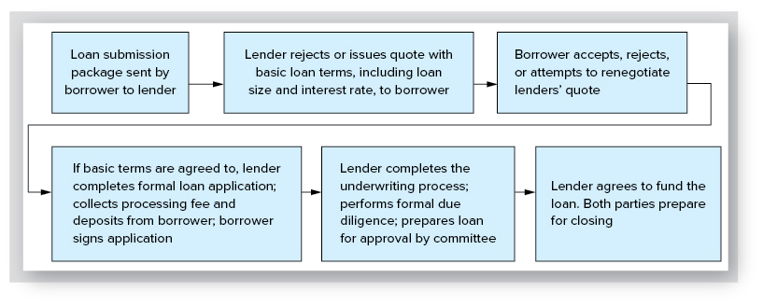
Loan Submission, Application, & Approval: An Illustration
Exhibit 16-4

Slide 42
So…How Long Does This Take?
A commercial loan may take 90 days from signing of purchase & sale contact until loan closing
But…some loans can be processed in < 45 days
Time depends on numerous factors
Loan application is nonbinding
But…loan commitment is a written agreement that commits lender to make the loan to the borrower provided borrower satisfies terms and conditions of commitment

Slide 43
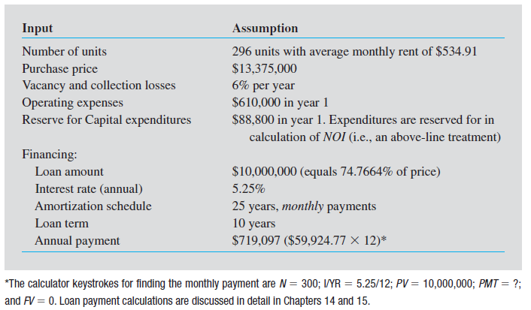
Loan Underwriting: Crunching the Numbers
Exhibit 16-5

Slide 44
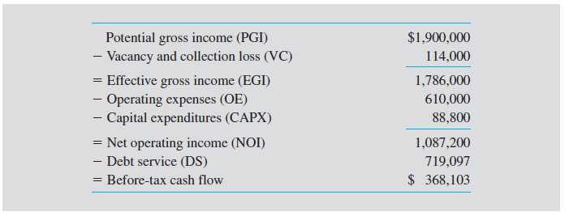
Gatorwood Before-Tax Cash Flow from Operations
Exhibit 16-5

Slide 45
Gatorwood Debt Coverage Ratio
$$DCR= \frac{{NOI}_{1}}{DS}= \frac{\$1,087,200}{\$719,097}=1.51$$
NOI in first year of operations is expected to be half again as large as mortgage payment
Thus, there appears to be sufficient protection against a deterioration in the property’s operating performance

Slide 46
Gatorwood: Determining Maximum Available Loan
$$Maximum debt service= \frac{{NOI}_{1}}{Minimum DCR}= \frac{\$1,087,200}{1.35}=\$805,333$$
Implies a maximum monthly payment of $67,111 ($805,333/12)
With a 5.25% interest rate and 25-year term, implies a maximum loan of $11,199,208 (or 83.7% LTV)
300 5.25/12 67,111 0
N
I
PV
PMT
FV
11,199,208

Slide 47
Gatorwood: Determining Maximum Available Loan
It appears the property’s NOI can support an $11,199,208 loan
However, maximum loan will be determined by lender’s maximum allowable LTV if it is less than 83.7% (which is likely)

Slide 48
Construction & Development Financing
Land acquisition financing
To finance purchase of raw land
VERY risky; by nature this is speculative development
No presale contracts with ultimate buyers of land to reduce risk
Lenders offer these loans on an exception basis at low leverage (25%-35% LTVs) to their very best clients

Slide 49
Construction & Development Financing
Land development loan
To finance installation of improvements to the land (sewers, utilities, etc.)
If land is ready for development, demand for expected finished product is less uncertain
Lenders will typically require presale contracts with homebuilders or ultimate buyers of the land
Typical leverage: 50%-65% of expected sellout value of land/lots (based on appraisal)

Slide 50
Construction and Development Financing (continued)
Construction loan
To finance vertical construction
Arguably, collateral securing construction loan is more valuable than collateral securing land acquisition & development loans
Typical LTV: 65%-75%
Typical term: 1-3 years; allow time to construct & lease up the project

Slide 51
Construction and Development Financing (continued)
Construction loan, cont.
Often have preleasing requirements (ex. 50% of space must be preleased)
Due to risk of these loans, lenders
Carefully screen experience of developers & the value of their guarantees
Perform substantial due diligence & market research
Permitting approval status, construction plans/specs, quality of architect/engineer/general contractor, environmental and soil reports
Hire an engineer to monitor construction
May require a “takeout” commitment from a permanent lender upon stabilization or allow loan to convert to an amortizing 3-5 year balloon loan

Slide 52
End of Chapter 16

