Slide 1
Chapter 17:
Sources of Commercial Debt and Equity Capital

Slide 2
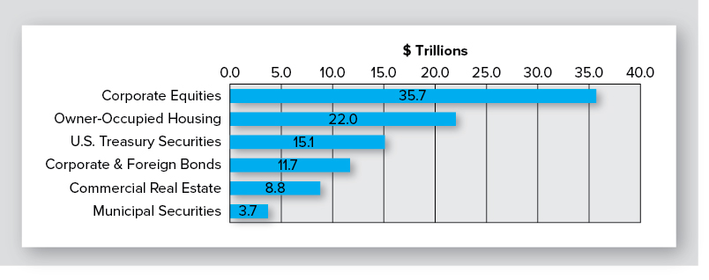
How Large is U.S. CRE Market?
Exhibit 17-1
(Year-end 2015)
2015Q4: $35.7 Trillion
2015Q4: $22.0 Trillion
2015Q4: $11.7
2015Q4: $15.1
2015Q4: $8.8
2015Q4: $3.7
Source: Data from Flow of Funds Accounts of the United States Federal Reserve, March 10, 2016, various tables, www.federalreserve.gov. Estimate of investible CRE is from CBRE Global Investors (ww.cbreglobalinvestors.com). CRE owned by non-RE companies & by federal, state, & local governments.
Note: $8.8 trillion of investible CRE excludes CRE owned by non-RE companies and by federal, state, and local governments

Slide 3
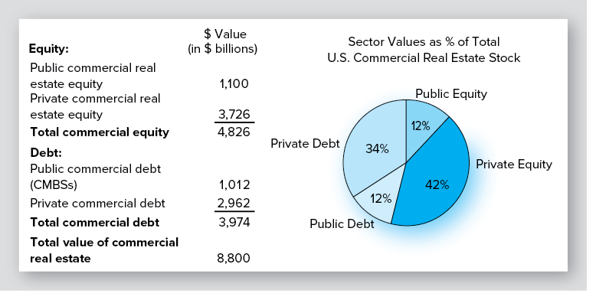
Value of U.S. CRE?
Exhibit 17-2
Direct vs. securitized investments?
How leveraged is commercial RE?

Slide 4
Forms of Ownership for Pooled Equity Investments
Due to large size of typical RE investments, investors almost always pool their equity capital
General partnership
Limited partnership
C corporation
S corporation
Limited liability company
Tenancy-in-common
REIT

Slide 5
Advantages of Pooling Equity
Allows investors to purchase an interest in larger properties
Diversification of portfolio
Economies of scale in acquisitions, management and disposition
Access to cheaper debt capital
Expertise of management team hired by syndicator/organizer

Slide 6
Disadvantages of Pooling Equity
Often must relinquish management control to active manager(s)
Must compensate sponsor/organizer with fees, salary &/or disproportionate share of equity ownership
➨ lower return on equity, all else equal

Slide 7
What Drives Choice of Ownership Form?
Federal income tax issues/rules
Desire of investors for limited liability
Management control issues
Ability to access debt & additional equity capital
Ability to share risk with other investors
Including “special allocations”
Ability of investors to dispose of their interests

Slide 8
Multiple Levels of Organizations
Multiple levels of ownership are commonly at work in CRE investments
Ex., office building owned by a limited liability company (LLC) whose two “members,” in turn, are a LLC and a publicly-traded REIT

Slide 9
A Quick Tour of Possible Ownership Forms

Slide 10
General Partnership
Treated as conduit for tax purposes… investors avoid double taxation
All partners can make operating decisions:
How much leverage; when to sell, etc.
No separation between ownership & control; lessens potential conflicts of interest
Share of cash flow & taxable income determined by partnership agreement
“special allocations” permitted

Slide 11
General Partnership-Disadvantages
General partners liable for all debts
Contractual debts, debts arising from legal actions, wrongful acts committed by other partners…
So…personal assets are subject to claim’s of the partnership’s creditors
Result?
Fairly uncommon & those that are created have few partners

Slide 12
Limited Partnership
Creates 2 types of partners: general & limited
GP who sponsors/organizes venture is usually a knowledgeable builder, broker, or investor
“Flow-through” tax treatment
Limited liability for LPs; unlimited for GP
But GP may be a corporation, LLC, etc.….
LPs give up control of management & policy making
A “principal-agent” relationship is created with its attendant problems

Slide 13
C Corporations
Legal & taxable entity separate from shareholders
Therefore potential double taxation
All shareholders have limited liability
Separation of ownership & control
which creates agency problems
Many non-RE C corporations own real estate, but not a desirable structure for investing in RE

Slide 14
S Corporations
Limited liability for shareholders
S corps pay no taxes; taxable income is passed through to stockholders who pay taxes
≤ 100 shareholders
All CFs & taxable income allocated on a pro rata basis
i.e., “special” allocations are not allowed
Used in some cases by individuals & families to own CRE

Slide 15
Limited Liability Companies
NOT a corporation, partnership, or sole proprietorship
IS a blend of some of best characteristics of corporations, partnerships, & sole proprietorship
➨ a “super pass through entity”
IS a separate legal entity (like a corporation), but is treated as a partnership for tax purposes

Slide 16
Limited Liability Companies
Relative to LPs, LLCs
permit all owners to participate in management &
have limited liability
Managing member creates “operating agreement” that explains operation & management of entity
Limits decision making ability of passive investors

Slide 17
Tenancy in Common (TIC)
TICs-one of the oldest forms of co-ownership
Essentially, fee simple ownership interest with multiple owners:
Investors receive separate deed…are direct owners
Investors may hold different ownership percentages, otherwise interests are indistinguishable
i.e., investors share “pro rata” in CFs, tax consequences, & price appreciation
≤ 35 investors
Generally considered bad form for investing in CRE
joint & several liability

Slide 18
Optimal Ownership Form?
LLCs & LPs are dominant ownership structures
RE private equity funds typically set up as LPs
Small, “local” investments marketed to accredited, but non-institutional, investors typically set up as LLCs

Slide 19
Ultimate Equity Investors
Investors can hold ownership (equity) positions directly or through intermediaries
ex., funds, LLCs, LPs
But…most inventors can’t invest directly
For well capitalized investors, choice of direct vs. indirect involves trade-offs between:
control
access to managerial expertise
liquidity &
risk sharing

Slide 20
Direct Investment
Gives individual & institutional investors complete control:
who leases it, who manages it, how much debt financing is used, when it is sold…
But…investor must supply the expertise
Liquidity of direct investments reflects the liquidity of the underlying property market
i.e., there is no liquidity!

Slide 21
Direct Investment
As size of investor's portfolio increases, the economics of direct ownership make more sense; i.e., easier to
retain in-house experts or hire consultants
diversify risk
create liquidity across assets classes (stocks, bonds, etc.)

Slide 22
Direct Investment
Direct ownership also prevalent at smaller end of investor spectrum
Single-family rental homes, duplexes and fourplexes
Owner-occupied office buildings
Lack of diversification vs. local market knowledge?

Slide 23
Tenancy in Common (TIC)
TICs-one of the oldest forms of co-ownership
Essentially, fee simple ownership interest with multiple owners:
Investors receive separate deed…are direct owners
Investors may hold different ownership percentages, otherwise interests are indistinguishable
i.e., investors share “pro rata” in CFs, tax consequences, & price appreciation
≤ 35 investors
Generally considered bad form for investing in CRE
joint & several liability

Slide 24
Optimal Ownership Form?
LLCs & LPs are dominant ownership structures
RE private equity funds typically set up as LPs
Small, “local” investments marketed to accredited, but non-institutional, investors typically set up as LLCs

Slide 25
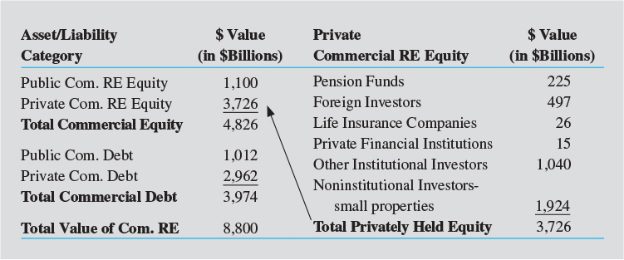
Value of U.S. CRE Equity
Exhibit 17-3
Source: Data from CBRE Global Investors, ACLI Fact Book 2016, Flow of Funds Accounts of the United States Federal Reserve, March 10, 2016, www.federalreserve.gov; Real Capital Analytics; National Council of RE Investment Fiduciaries; National Association of Real Estate Investment Trusts.

Slide 26
Institutional Investors in Private Equity Markets
Pension funds
Long-term liabilities well suited to LT RE investments
Direct purchases as well as acquisitions through funds

Slide 27
Institutional Investors in Private Equity Markets
Life insurance companies
Long-term liabilities a good match for long-term, illiquid, private RE investments
More active as CRE lenders than as equity investors

Slide 28
U.S. CRE: A Favorite among Foreign Investors
Several recent high profile foreign investments
China Life Insurance Co. recently purchased a $1.65 billion Manhattan office tower
But “real story” lies in growth of foreign investment in small-to-medium sized U.S. CRE properties
Marketplace (peer-to-peer) lending gives foreign investors opportunity to participate—as lenders—in U.S. CRE
Matching borrowers & lenders through online platforms
Borrowers able to gain access to funds quickly & typically at lower interest rates than banks

Slide 29
“Other” Institutional Investors
Hedge funds, endowment funds, real estate private equity funds

Slide 30
Institutional vs. Non-Institutional Equity Investors
$1.8 trillion (48%) of $3.7 trillion in private equity held by institutional investors
Remaining $1.9 trillion (52%) held by (mostly) high net worth investors
Who are these investors & how do they invest?
Exhibit 17-3 (partial)

Slide 31
Investors in Private RE Equity Markets (non-institutional)
High net worth individuals & families that invest
“indirectly” in JVs/LLCs organized by others
“directly” (although they form LLCs, etc.)
None-institutional investors in private equity funds
The “great investor masses” that invest in private “local” RE syndications that form LLCs
So…who owns the stock of CRE in U.S.?
Exhibit 17-3 (partial)

Slide 32
Investment Through Intermediaries: Other Private Market Investment Vehicles
Private equity funds
Did not really exist prior to early 1990s
Mostly finite life (typically 7-10 years)
Although manager can typically extend life a year or two
Typically include some degree of side-by-side investment by fund manager/sponsor
Sponsor invests as both GP and LP
Aligns manager’s incentives & returns with investors

Slide 33
Investment Through Intermediaries: Other Private Market Investment Vehicles
Private equity funds-continued
LPs earn a preferred return (e.g., 8%) before GP earns bulk of its expected fees/return
Once LPs’ IRR exceeds threshold, GP receives a disproportionate share of remaining cash distributions– called “carried interest”
Disproportionate relative to what?
20% is a typical carried interest
which is more than a pro rata share
Looking ahead…how is risk being shared?

Slide 34
Real Estate Investment Trusts
Although vast majority of commercial RE is owned in private markets, $404 billion (is owned & traded in private markets…mostly REITs
REITs can be described as mutual funds for investing in RE
Diversification benefits
Liquidity
Types of REITs?
Equity REITs
Mortgage REITs

Slide 35
Types of Listed REITs (as of March 31, 2017)
Percentages Based on Market Capitalizations
94% EQUITY REITs
Own commercial real estate—derive revenues primarily from rents
6% MORTGAGE REITs
Invest in mortgages or MBS— derive revenues primarily from interest payments
Total equity market capitalization

Slide 36
Real Estate Investment Trusts
REITs not taxed at corporate level if they satisfy a set of restrictive conditions on an ongoing basis including:
At least 100 shareholders
75% of assets must be RE, cash, or government securities
75% of gross income must come from RE assets
90% of REIT taxable income must be paid out in dividends each year
Taxed to some extent if > 90% but < 100% of taxable income is distributed

Slide 37
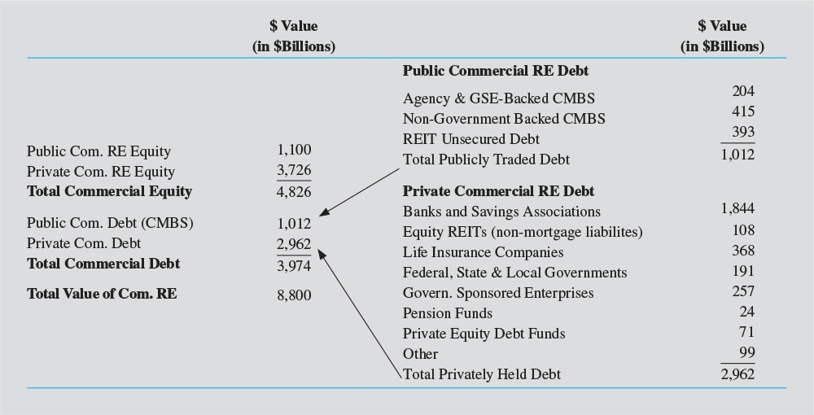
Sources of CRE Debt
Exhibit 17-4
Source: Data from Flow of Funds Accounts of the United States Federal Reserve, March 10, 2016, various tables, www.federalreserve.gov.

Slide 38
Sources of CRE Debt
75% of outstanding commercial mortgage debt (or $2.96 trillion) is privately held by individuals & institutional investors:
Commercial banks
Savings associations
Life insurance companies
Freddie & Fannie (multi)
State & local governments

Slide 39
Commercial Banks are Major Providers of permanent CRE Mortgages
Commercial banks hold in portfolio 46% ($1.84 trillion/$3.973 trillion) of existing CRE debt
62% of private CRE debt

Slide 40
Sources of CRE Debt
24% ($1.0 trillion) is publicly traded
GSE-backed commercial mortgage-backed securities (CMBSs)-all multifamily
Non-government backed (“private label”) CMBS
Investment grade unsecured debt of large REITs
CMBS originations about $100 billion in 2014 & 2015… about $67 billion in 2016

Slide 41
Can You Tell a “Story” About the Value and Ownership of CRE Debt & Equity?
Exhibit 17-2

Slide 42
Development & Construction Lending
Can be extremely risky
Developer will fail to complete the project in a timely manner or fail to complete it at all
Builders may experience cost overruns, poor weather, strikes, structural or design problems, or difficulties with subcontractors
Builder may simply be a bad manager
Failure to pass various building code inspections may delay ability of tenants to occupy building (and pay rent)

Slide 43
Development & Construction Lending
All of these risks are assumed by construction lender
Thus, construction lenders must have specialized skills in monitoring and controlling the construction process
Because risks are significant and much different than risks of long-term lending, the capital sources for development & construction loans differ significantly from permanent financing
Construction loan market is dominated by commercial banks

Slide 44
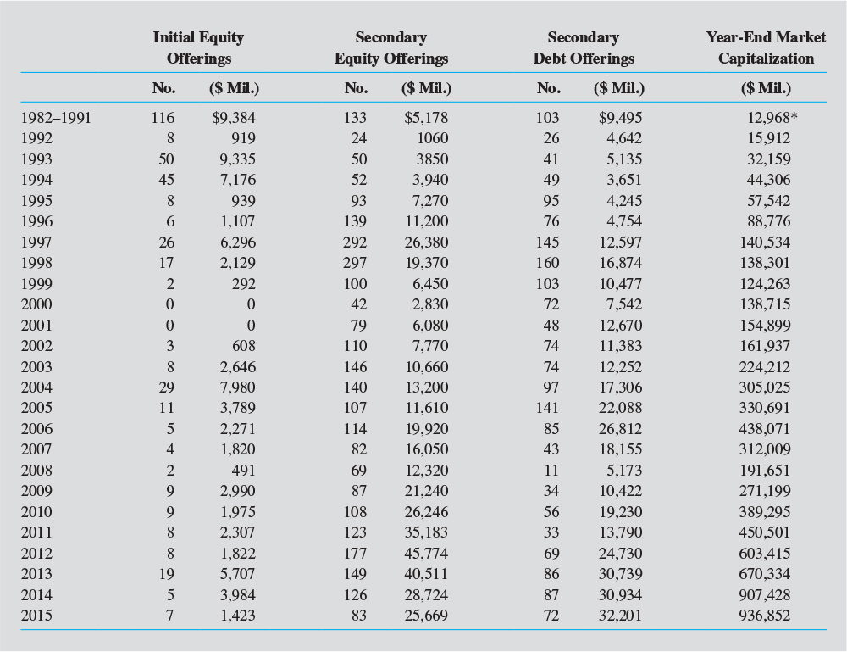
A Closer Look at REITs
Measures of importance of REITs include equity and debt offerings and stock market capitalization

Slide 45
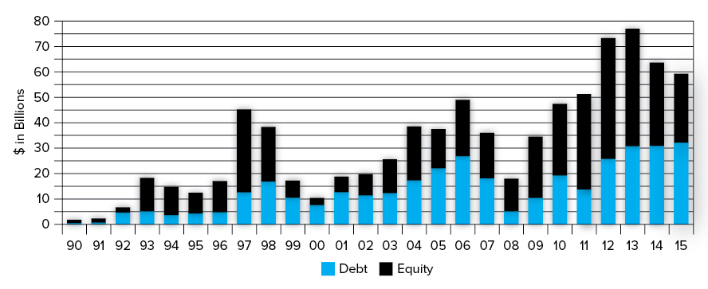
Security Offerings by REITs
Exhibit 17-6
Large surge in capital raising in 97-98, 04-06, and 2011-2013; capital raised by REITs is primarily used to acquire properties

Slide 46
Types of Listed REITs, Continued
REITs distinguish themselves by their focus/specialization
geographically (by region, state, or metro area) and/or by
property type (retail, industrial, office, apartments, etc.)
What does stock market tend to reward/punish?
REIT Cafe: http://treppreitcafe.com/

Slide 47
REIT Industry: as of March 31, 2017
224 REITs in FTSE NAREIT All REIT Index
186 equity REITs
38 mortgage REITs
≈ 50 public, non-listed REITs
Listed REITs own 112,375 properties (≈ $1.8 trillion in value)
Listed REITs own 15,691 properties ($92 billion) in FL (http://www.reitsacrossamerica.com/)
FTSE is an independent company owned by The Financial Times and the London Stock Exchange. Its sole business is the creation and management of indices and associated data services.

Slide 48
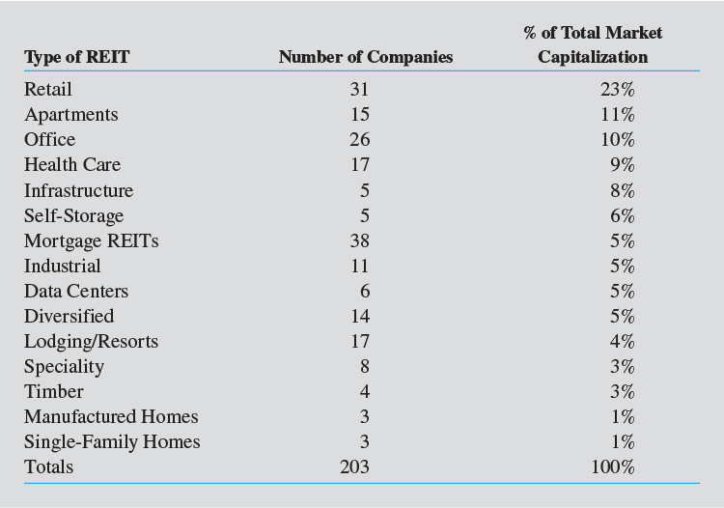
In What Do REITs Invest?
Exhibit 17-7
“Core” REITs invest in retail, apartment, office, & industrial properties
But many non-core REITs exist

Slide 49
Types of REITs
In addition to listed (publicly-traded) REITs, there are 2 additional REIT forms:
Private REITs
Public, non-listed REITs (PNLRs)

Slide 50
Private REITs
Privately issued & narrowly held
Not publicly registered or listed on a stock exchange
Private placement sold to accredited investors
Because data are limited to IRS filings, private REIT counts & info are difficult to obtain
NAREIT estimates ≈ 800 private REITs

Slide 51
Public Non-Listed REITs (PNLRs)
Publicly registered & publicly offered, but not listed on an exchange
Marketed by brokers through financial advisors
Minimum investment: $5-$10 thousand

Slide 52
Public Non-Listed REITs (PNLRs)
Governed by regulatory environment that applies to all publicly registered securities
Must issue a prospectus & file 10-K’s, etc. with SEC
Must follow FASB /GAAP; disclosure must conform to Sarbanes-Oxley
These are NOT private placements
But….they “look & feel” like closed-end private equity funds

Slide 53
What is an “UPREIT”?
Section 1031 of IRC allows “like-kind” tax-deferred exchanges, which REITs routinely use to acquire properties from other REITs
However…
Most U.S commercial RE is held in private markets by LPs or LLCs
REITs can’t acquire LP or LLC interests from property owners in exchange for cash or stock (or even RE)
Would violate like-kind requirement

Slide 54
UPREITs, continued
In November 1992, a new form of REIT emerged to facilitate tax-deferred exchanges
Taubman Centers completed IPO with an “UPREIT” structure
“Umbrella partnership REIT" ("UPREIT") structure proved popular in attracting capital
Since Taubman, more than 75% of new REITs have taken this form

Slide 55
How Does UPREIT Structure Work?
In typical UPREIT, partners in an existing partnerships & a newly-formed REIT become partners in a new LP termed the “operating partnership” (OP)
Owners transferring LP interests into OP receive units in OP w/o triggering a taxable sale
If they received REIT stock or cash it would trigger a taxable gain

Slide 56
How Does UPREIT Structure Work?
Recipients of OP units receive distributions from OP
These “dividends” are equal to dividends paid to REIT shareholders
REIT is general partner & majority owner of OP Units

Slide 57
A Typical UPREIT Structure

Slide 58
Measuring REIT Income: Funds From Operations (FFO)
REIT-level cash flow, expressed as “Funds from Operations” (FFO), is often used instead of accounting net income to measure current performance
FFO is a supplemental measure of a REIT's operating performance

Slide 59
Funds From Operations (FFO)
FFO =
Net (accounting) income (excluding gains/losses from sales of property)
+ Depreciation (real property)
+ Amortization of leasing expenses
+ Amortization of tenant improvements
- Gaines/losses from infrequent & unusual events

Slide 60
Funds From Operations (FFO)
FFO is different from GAAP net income because commercial RE maintains value to a much greater extent than may other assets
Thus, economic depreciation < tax depreciation
Security analysts judge REIT performance according to FFO growth
Price / FFO multiples reflect underlying RE value, management quality, and growth potential

Slide 61
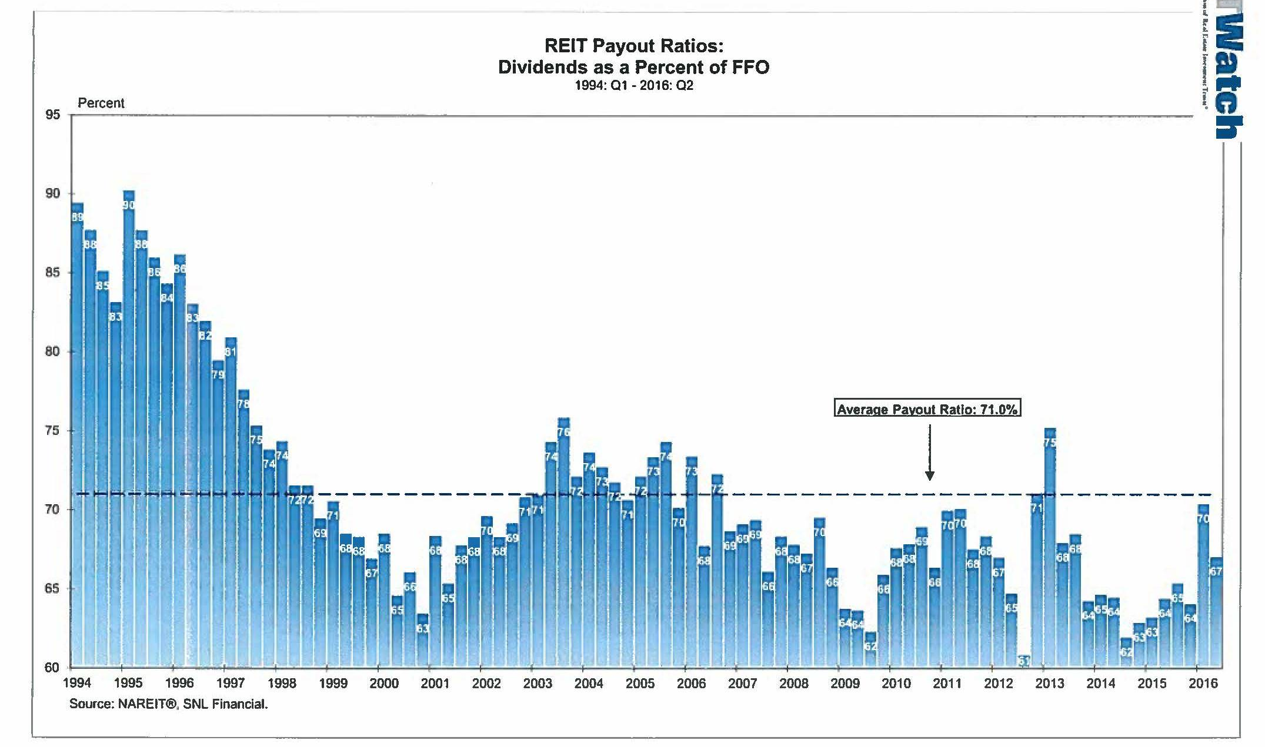
Dividends as a % of FFO
REITs not as cash constrained as some think

Slide 62
How Are REIT Stocks Valued?
To determine share values, typical analyses involves one or more of the following criteria:
Management quality;
Current prevailing dividend yield
Anticipated total return from the stock
Capital Sources
Because REITs are obligated to distribute 90% of taxable income, they usually require external funding sources

Slide 63
How Are Total Returns Estimated?
Investors attempt to forecast dividends REIT will pay out over time.
This projected dividend stream is converted into a present value
In practice, however, long-term dividend projections are difficult to develop

Slide 64
Net Asset Value
A commonly used valuation approach centers around concept of net asset value (NAV)
NAV is equal to estimated total market value of a REIT’s underlying assets, less all liabilities including mortgages

Slide 65
How is NAV Used to Make Decisions?
If stock price per share > its NAV per share, REIT is said to be selling for a “premium” to NAV
A stock price in excess of per-share NAV may indicate a REIT is overpriced relative to value of assets currently in the portfolio
Conversely, REITs selling at “discounts” to NAV may signal buying opportunities for investors
Or may reflect that the market belies the company is not well-managed/has low growth prospects

Slide 66
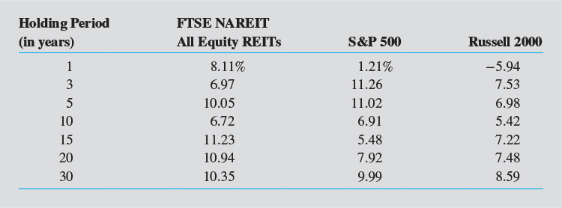
REIT Total Return Performance
Exhibit 17-8
Equity REITs have performed well relative to both large cap & small cap stocks
REITs also help to diversify portfolios that contain only stocks and bonds

Slide 67
REITs in S&P 500
In 2001, Standard & Poor’s added Equity Office Properties (EOP) to S&P 500
27 REITs now included (as of Oct. 2016)
http://www.reit.com/REIT101/REITDirectory/REITsinSPIndexes.aspx
Indicates acceptance of REITs as a mainstream investment

Slide 68
REIT Funds (as of Oct. 31, 2016)
72 actively managed open-end REIT mutual funds
Fund that issues or redeems shares at NAV
http://www.reit.com/Investing/ListofREITFunds/MutualFunds.aspx
16 closed-end funds
investment co. that issues fixed # of shares with IPO
After IPO, shares trade like regular stocks
Price of shares = its market price, not fund's NAV
http://www.reit.com/Investing/ListofREITFunds/Closed-EndFunds.aspx
28 exchange traded funds
http://www.reit.com/Investing/ListofREITFunds/Exchange-TradedFunds.aspx
66 global funds
http://www.reit.com/Investing/ListofREITFunds/GlobalFunds.aspx

Slide 69
Global Real Estate Securities?
Following lead of U.S., many countries have established REIT regimes during last 40+ years
Same attributes that have driven growth of REITs in U.S. are fueling this growth
Diversification
Dividends
Transparency
Liquidity, and
Performance
Comprehensive index for the REIT & global listed property market is the FTSE EPRA/NAREIT Global Real Estate Index Series: https://www.reit.com/data-research/reit-indexes/real-time-index-returns/enhgeur-ftx

Slide 70
Global Expansion of REIT Market-- Increasing Investment Opportunity
https://www.reit.com/investing/reit-basics/global-real-estate-investment

Slide 71
End of Chapter 17

