Slide 1
Chapter 20:
Income Taxation and Value

Slide 2
Federal Income Taxation
If RE investors are successful, the federal (& usually state) government shares in that success
If RE investors lose, federal government may not share in losses
Income taxes have a significant effect on returns that can ultimately be consumed or invested by investor/taxpayer
Result?
  Market values/prices significantly affected by tax law

Slide 3
Taxation of Individuals & Corporations
For investing in real estate…
    The double taxation of income renders C corporations a less desirable form of ownership than “flowthrough” entities such as LLCs and LPs
We therefore focus on the taxation of individuals who investment in RE via flowthrough entities

Slide 4
IRS Tax Classifications for Real Estate
RE held
  as a personal residence
  for sale to others (dealer property)
  for use in trade or business (section 1231 assets)
  for investment (capital assets)

Slide 5
IRS Tax Classifications
Important because they:
  determine if depreciation is allowed
    personal residences & “dealer” property can’t be depreciated
  may affect taxes due on sale
    Net gains from sale of trade or business property (held for a year) are taxed at capital gain tax rates*
    Net losses on “trade or business” property are deductible w/o limit against ordinary income
    *However, the net gain on 1231 assets is treated as ordinary income to the extent of the taxpayer’s net 1231 losses clamed during the most recent 5 years

Slide 6
IRS Tax Classifications
Investment property
  Losses on sales of investment assets are generally limited
  Generally can’t be depreciated
Is rental RE “investment property” or “trade or business” (Section 1231) property?
http://www.irs.gov/index.html
IRS website

Slide 7
Income Subject to Taxation
Active Basket
Portfolio Basket
rrrrrrrrrrrr
Passive Basket
+ Salary Income
+ Consulting Income
+ Sales
Commissions
= Net Active
Income
+ Interest
+ Dividends
+ Annuities
+ Cap Gains on
Stocks
- Interest incurred in
Producing Income
= Net Portfolio
Income
+ Taxable Income from
Business in which no
“Material Participation”
+ Any Rental Income
Any Expenses from
Producing Rental
Income
= Net Passive Income
Taxed at ordinary rates
Taxed at ordinary or capital gain rates
Ordinary, capital gain, and/or recapture rates

Slide 8
Passive Activity Loss Restrictions: Summary
Taxable income & losses (not cash flow) on all passive activities are first netted
If net passive income is negative, it cannot be used to offset active or portfolio income
Disallowed passive losses are carried forward until taxpayer has sufficient passive income to deduct deferred losses
To use losses from one passive investment, taxpayer needs other passive activities that are producing positive taxable income in that year
  i.e., “PALs” need “PIGs”

Slide 9
Important Exemptions
$25,000 annual exemption for taxpayers with AGI < $100,000 (not changed since 1986)
  With inflation should now be about $190,000
For every $1.0 over $100K in AGI, taxpayer losses $0.50 of the $25K exemption
  AGI $100K $110K $125K $140K $150K
  Lost exemption $ 0K $ 5K $12.5K $ 20K $ 25K
  Remaining exemption $ 25K $ 20K $12.5K $ 5K $ 0K

Slide 10
Important Exemptions
$25,000 exemption for taxpayers with AGI < $100,000
Corporations not subject to PAL restrictions
If taxpayer’s primary business is “real estate” (at least 750 hours per year), net tax losses from RE rental activities may be used to offset income from providing the following RE services:
  Development, Construction, Acquisition, Management, Brokerage, Leasing, and others

Slide 11
Two Examples of $25,000 Exemption Phase Out

Slide 12
Federal Tax Rates

Slide 13
Average vs. Marginal Tax Rates
If single taxpayer had $50,000 in 2016 taxable income, total federal tax
= $5,183.75 + 0.25 ($50,000-$37,650)
= $8,271.25
Marginal Rate:
= 25%
Average Rate:
$8,271.25/$50,000 = 0.1654 or 16.5%

Slide 14
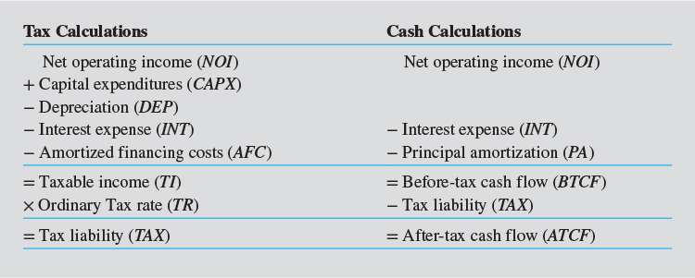
Estimating Tax Liabilities from Operations: Exhibit 20-3
Need to review Chapters 8 and 18
Investors are concerned with CFs, but tax calculations are required to get to the net CFs received by investor
Because all CAPX was subtracted from EGI in the calculation of NOI, all CAPX must be added back in the cash calculations. Why? Because CAPX are not deductible in the year in which they are incurred (they are depreciated)

Slide 15
Estimating Tax Liabilities from Operations: Exhibit 20-3
Mortgage payment
Big driver of difference between TI and BTCF? Depreciation

Slide 16
Cost of Mortgage Financing
Mortgage interest is generally deductible in the year paid
Repayment of loan principal is not
Up-front financing costs on trade or business properties or investment properties are amortized over life of loan
  If loan is prepaid before up-front costs are fully deducted, remaining costs can be deducted in year of sale

Slide 17
Calculating Tax Depreciation
What is "conceptual" basis for tax depreciation?
What determines amount of tax depreciation?
1. Original depreciable basis
2. Cost recovery period
3. Method of depreciation

Slide 18
Depreciable Basis of Existing Property
Starting point is original cost basis, which is equal to total acquisition price of property:
  Land, building, & personal property
Original depreciable basis for existing property:
  Original cost basis - land value
Depreciable basis of the real property:
  Original depreciable basis minus value of personal property

Slide 19
Depreciable Basis of Existing Property
Original cost basis (typically, price + acquisition costs)
- Land value
= Original (total) depreciable basis
  - Value of personal property
= Depreciable basis of real property

Slide 20
Cost Recovery Periods
Cost recovery periods for real (not personal) property:
  27.5 years for "residential" income property
  39.0 years for "non-residential" income property
  (31.5 if placed in service before May 13, 1993)
Distinction between residential & non-residential income property?
What determines amount of tax depreciation?
1. Original depreciable basis
2. Cost recovery period
3. Method of depreciation

Slide 21
Methods of Depreciation
Straight-line method
For 27.5 year residential:
For 39 year commercial:
Depreciation tables supplied by IRS
“Mid-month” convention?

Slide 22
Methods of Depreciation for Personal-Not Real-Property
Declining balance methods (i.e., accelerated)
For 150% declining balance & 15-year recovery period:

Slide 23
Depreciation of Personal Property
Cost recovery periods for personal (not real) property:
  Carpeting & draperies: 3 years, 200% declining balance.
  Office equipment & fixtures: 7 years, 200% declining balance
  Landscaping & sidewalks: 15 years, 150% declining balance
What is “cost segregation”?
  see Industry Issues 20-1

Slide 24
Depreciation Creates Tax Shelter
Rental Income
Owner’s Cash Flow
Owner’s
view
Loan Payments
(Interest only Loan)
Operating Expenses
1 2 3 4 5 Year
Taxable Cash Flow
IRS
view
Depreciation
Loan Payments
Operating Expenses
1 2 3 4 5 Year

Slide 25
Other Taxing Issues
Treatment of operating expenses vs. capital expenditures
Substantial improvements
  CAPXs made after initial purchase are treated as a separate building or improvement
    Depreciation begins in year of expenditure

Slide 26
Centre Point Office Building
Tax assumptions contained in Exhibit 20-5
  80% of $1,056,000 price (original cost basis), or $844,800, is allocated to depreciable real property
  20% allocated to land (i.e., no personal property)
  Investor in 30% tax bracket on ordinary income
Total up-front financing cost of $23,769 ($792,000 x 0.03) are amortized over loan term (30 years)

Slide 27
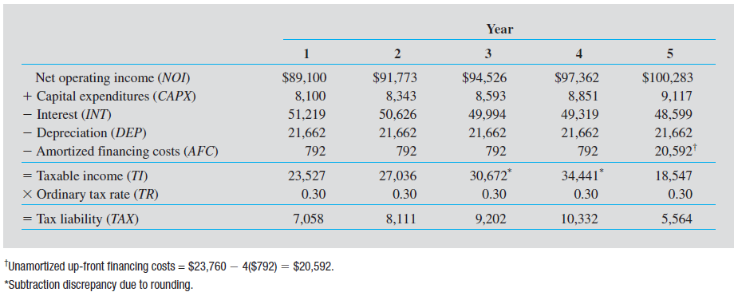
Centre Point Office Building: Estimated Taxes From Operations
Exhibit 20-6
CFs over the next 12 months

Slide 28
Centre Point Office Building: Estimated Taxes From Operations
Exhibit 20-6
792 = $23,769/30
Assuming, for simplicity, that CAPX are added to tax basis but not depreciated; thus, the constant $21,662 depreciation deduction is based on the original depreciable basis of $844,800 ($844,800/39 = $21,662). Calculation ignores mid-month convention.

Slide 29
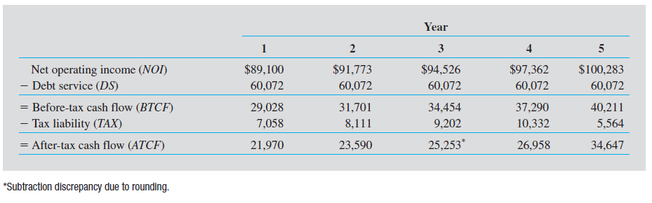
Centre Point: Estimated After-Tax Cash Flows From Operations
Exhibit 20-6

Slide 30
Estimating Tax Liabilities from Sale
Fully taxable transactions
  When seller receives full payment from buyer in year of sale
Tax-deferred transactions
  Section 1031 “like-kind “exchanges

Slide 31
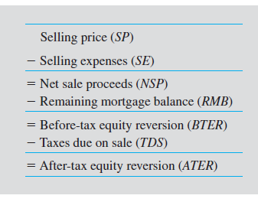
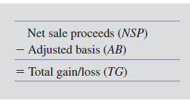
Fully Taxable Sale
Cash Calculations
Exhibit 20-9
Tax Calculations
Exhibit 20-11
Includes land
Important!! Total gain/loss (TG) is NOT equal to BTER!!!

Slide 32
Types of Income Generated by Sale of Property
Total gain/loss from sale of property (TG) must be allocated to the following categories:
  Ordinary income
    39.6% max. statutory federal rate
  Capital gain income
    20% max. statutory federal rate
  Depreciation recapture inc. income
    25% max. statutory federal rate
Exhibit 20-11

Slide 33
Types of Income Generated by Sale of Property
Total gain/loss from sale of property (TG) must be allocated to the following categories:
  Ordinary income
    39.6% max. statutory federal rate
  Capital gain income
    20% max. statutory federal rate
  Depreciation recapture inc. income
    25% max. statutory federal rate
Exhibit 20-11
As a result of legislation passed at the end of 2012:
For married HHs, 20% rate applies to taxable income > $466,951 in 2016
In addition, married HHs with AGI > $250,000 owe an “Obama Care” surcharge of 3.8% on their investment income, including capital gains and rental income
Results: max rate on CG income, 23.8% (20%+3.8%); on rental income, 43.4% (39.6%+3.8%); on depreciation recapture income, 28.8% (25%+3.8%)

Slide 34
Good News and Bad News at Sale of Investment Real Estate
Net Sale
Price
Net Sale Price: Price
less expenses of sale
Acquisition
Cost
Long-term Capital Gain
Appreciation
Taxed favorably
Total Depreciation Claimed
Taxed unfavorably
Acquisition Cost:
Price plus other
acquisition expenses
Depreciated Value
0 1 2 3 4 5 6 7 8 9 10 Year

Slide 35
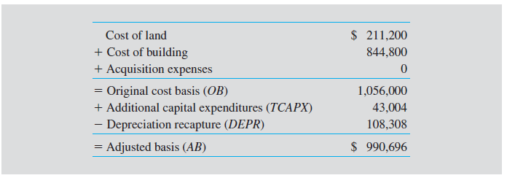
Adjusted Tax Basis: Centre Point
Exhibit 20-14
Don’t forget to include land
5 x $21,661.5
Note: $43,004 is total amount of CAPX over 5-year holding period; it is assumed for simplicity that CAPXs were added to the tax basis each year but NOT separately depreciated

Slide 36
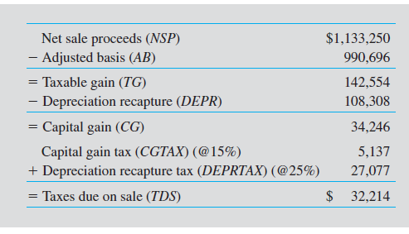
Taxes Due on Sale: Centre Point
Exhibit 20-15
From Exhibit 20-15
0.25 x 108,308

Slide 37
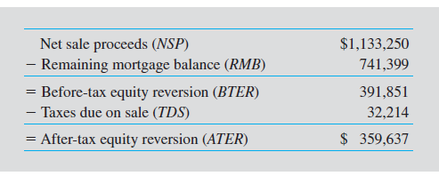
After-Tax Equity Reversion: Centre Point
Exhibit 20-16
Note: Total Taxable Gain is $142,554 (Exhibit 20-16), which is $249,297 less than the estimated $391,851 BTER!

Slide 38
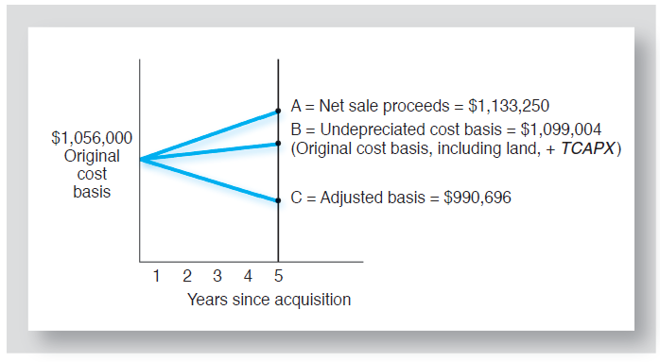
Components of Taxable Gain on Sale: Centre Point
Exhibit 20-17

Slide 39
Practice Problem
5 years ago you purchased a small apartment complex for $1 million (original cost basis).
The original depreciable basis was $750,000
Annual depreciation deduction = $27,272.73
Total depreciation-5 yrs = 5 x $27,272.73 = $136,364
No capital expenditures have been made since acquisition.
If you sell the property today for $1,270,000, what will be the taxes due on sale?
  Assume 6% selling costs, 33% ordinary income tax rate, a 15% capital gains tax rate, and a 25% recapture rate.

Slide 40
Practice Problem: Solution

Slide 41
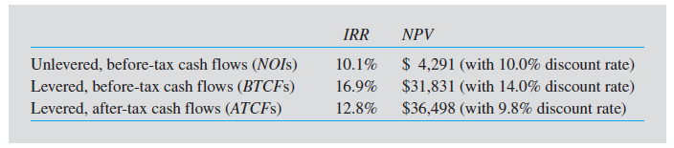
Effects of Debt & Taxes on Centre Point IRR & NPV
Exhibit 20-19
Why 9.8% after-tax discount rate?
9.8% = 14.0% (1 – 0.30)
After-tax opportunity cost of equity always < before-tax
Overall effective tax rate = 24 percent
= (16.9%-12.8%)÷ 16.9%)]

Slide 42
Tax Credits
Tax law allows taxpayers to take credits against tax liability for
  rehabilitation of older & historic structures
  construction & rehabilitation of qualified low-income housing

Slide 43
Tax Credits
A tax credit is a dollar-for-dollar reduction in tax liability (not taxable income)
  A $1 deduction for investor in a 30% tax bracket saves $0.30 in taxes
  A $1 credit save $1.0 in taxes

Slide 44
Rehabilitation Tax Credits
10% one-time credit may be taken on
  qualified rehab expenditures
  on nonresidential structures
  put in service before 1936

Slide 45
Rehabilitation Tax Credits
2. 20% one-time credit may be taken for rehab expenditures on residential or nonresidential structures so long as
  they are at least 50 years old, and
  listed on National Register of Historic Places or located in a registered historic district
Credit reduces depreciable basis $ for $

Slide 46
Low Income Housing Tax Credits
LIHTC is a federal tax credit for development or acquisition of “affordable” rental housing
Credits are:
  allowed each year for 10 years and
  in addition to regular depreciation deductions
Created by Congress in 1986
  Designed to provide incentives for private equity investment in low income housing
http://portal.hud.gov/hudportal/HUD?src=/program_offices/fair_housing_equal_opp/lihtcmou
HUD website on LIHTC

Slide 47
LIHTCs: How Are They Administered?
LIHTC is governed by federal tax code but administered by each state’s Housing Finance Agency (HFA)
  States have wide discretion
  Qualified Allocation Plans (QAPs)
      details state’s selection criteria & application requirements
  About 1/5 of projects that apply receive credits from state
Maximum amount of credits each state could (can) approve in 2016 = $2.35 x state population
  Amount is indexed to inflation

Slide 48
LIHTC: How is it Calculated?
For new construction not receiving other federal subsidies…
  Fixed credit is approximately 9% of “qualified” basis
    % is published monthly by IRS
    set such that PV of credits = 70% of qualified basis
For acquisition of existing buildings or new construction receiving other federal subsidies
  Fixed credit is approximately 4% of qualified basis

Slide 49
So…How Big are the Credits? Example
Local developer has applied for tax credits to build 70 units of low income rental housing. No federal funds will be used. Project will not be located in a “QCT” or “DDA.” 100% of the units will be set aside for low & rent restricted HHs.
Land acquisition $1,000,000
Dwelling construction 3,400,000 Site improvements 535,000
Architectural/engineering 40,000
Other eligible soft costs 25,000
Total development costs $5,000,000
Eligible basis = $4,000,000 (total dev. cost – land cost)
Qualified basis = $4,000,000 (eligible basis x 100%)
Annual credit = $360,000 ($4,000,000 x 9% credit)
Total credits = $3,600,000 ($360,000 x 10)

Slide 50
So…How Big are the Credits? Example
Land acquisition $1,000,000
Dwelling construction 3,400,000 Site improvements 535,000
Architectural/engineering 40,000
Other eligible soft costs 25,000
Total development costs $5,000,000
Assume investors/limited partners agree to purchase credits from developer for 75 cents on the dollar for a total of $2,700,000 ($3,600,000 x 0.75)
% of total development costs covered by selling credits = 54% ($2,700,000 / $5,000,000)
Credit purchaser must be part of the ownership entity
In QCTs or DDAs, credit is based on 130% of the qualified basis

Slide 51
LIHTCs: What are the Economics?
Developers/syndicators sell the tax credits by creating a LP or LLC
Why does it work?
  Without credits, rents would need to be MUCH higher to induce private investment
    Result? No new construction
  With credits, adequate returns can be earned even with rent restrictions
Majority of LIHTC projects receive other subsidies from local and/or state governments
  Below-market mortgage rates

Slide 52
So, What is a “Low-Income” Project?
Each project must meet one of the following tests continuously for 30 years:
  “20/50” test
  “40/60” test

Slide 53
So, What is a “Low-Income” Project?
“20/50” test
  At least 20% of units are occupied by HH’s with incomes 50% or less than county median income (adjusted for family size)
  Rent of LIHTC units can’t exceed:
    0.30 x 0.50 x county median income

Slide 54
So, What is a “Low-Income” Project?
“40/60” test
  At least 40% of units occupied by HH’s with incomes 60% or less than county median income
  Rent of LIHTC units can’t exceed:
    0.30 x 0.60 x county median income
If 100% of units are designated for low income usage, rent can’t exceed 0.30 x 0.60 x county median income

Slide 55
LIHTC: Main Drawbacks
Required to meet 15-yr initial compliance period and subsequent 15-yr “extended use” period
Credits subject to recapture with interest if
  criteria are not continuously satisfied for 30 years or if
  project is sold before end of 30-year compliance period
Passive activity loss rules limit ability of individual investors in flow through ownership entities (LPs, LLCs) to use credits
  Credits purchased by c-corporations

Slide 56
LIHTCs: What are the Economics?
Developers/syndicators sell the tax credits by creating a LP or LLC
Why does it work?
  Without credits, rents would need to be MUCH higher to induce private investment
    Result? No new construction
  With credits, adequate returns can be earned even with rent restrictions
Majority of LIHTC projects receive other subsidies from local and state governments
  Below-market mortgage rates

Slide 57
Deferring Taxes on Disposition
Like-kind exchange
  Sections 1031 of Internal Revenue Code allows owners of RE, under certain conditions, to exchange property for other property & avoid paying taxes at the time of transaction
    Note: taxable gain is deferred, not eliminated
  Like-kind exchanges have become commonplace in recent years

Slide 58
Tax Factors Affecting Homeowners
Deduction of Mortgage Interest:
  Benefit is proportional to owner’s marginal tax bracket
  After-tax cost of pmt = pmt - tax savings
= pmt - (interest x tax rate)
Note: The itemized deductions of upper income household are phased out

Slide 59
Tax Advantages of Home Ownership: Mortgage Interest Deduction
Monthly Loan Payment
Principal
Interest
Reduction of interest cost
through income tax deduction

Slide 60
Tax Factors Affecting Homeowners
Deduction of Property Taxes:
  Assume: 6,000 in taxes; 28% marginal tax rate
After-tax cost of pmt = pmt - tax savings
= $6,000 - ($6,000 x 0.28)
= $4,320

Slide 61
Tax Advantages of Home Ownership: Property Tax Deduction
Annual Property Tax Payment
Reduction of property tax cost
through income tax deduction

Slide 62
Tax Factors Affecting Homeowners
Exclusion of Capital Gains Tax for Homeowners
  Individuals can exclude $250,000 ($500,000 for married filing jointly) of taxable gain realized on sale of personal residence
    Taxable gain = NSP – adjusted basis
  To qualify, taxpayer must have owned & used property as his/her/their personal residence for at least two years during prior five years before sale

Slide 63
Tax Factors Affecting Homeowners
Discount Points Paid at Origination
  Fully deductible in year paid
Discount Points Paid on Mortgage Refinancing
  Amortized over life of loan
Other "Closing Costs" Charged by the Lender
  Added to tax basis (i.e, not deductible)
    Examples: Origination fee, credit checks, property appraisal, lender's attorneys fees
Costs Associated with Acquiring Property (Not the Mortgage)?

Slide 64
Deduction of Mtg. Interest is Not Primary Homeowner Tax Benefit
Assume household has $400,000 in wealth invested at average rate of 5%, generating $20,000 in investment income
Household purchases $200,000 home with all cash
  Tax effect? TI reduced by $10,000 (0.05 x $200,000)
2. Household purchases $200,000 home with $40,000 cash & $160,000, 5% mortgage
  Tax effect? TI reduced by $10,000
  $ 2,000 = decrease in invest. income (0.05 x $40,000)
  $ 8,000 = int. deduction (0.05 x $160,000)
  $10,000 = Total reduction in taxable income

Slide 65
Deduction of Mtg. Interest is Not Primary Homeowner Tax Benefit
So….if cost of mortgage is ≈ borrower's opportunity cost of invested equity (a reasonable assumption), replacing equity financing with more debt financing does NOT reduce tax liability
Moreover, phase-out of itemized deductions for higher income households may actually cause, at some LTV, equity financing to be preferred to debt financing

Slide 66
So….What is Primary Tax Benefit of Owner-Occupied Housing?
The non-taxation of return on equity….
  Periodic “implicit” rental income is not taxed if you own a home & rent it to yourself
  Capital gains are, effectively, not taxed for most households

Slide 67
End of Chapter 20

